Slide 1
Core Council Report
May 2017

Slide 2
How assessment used to feel

Slide 3
How assessment feels now…

Slide 4
….

Slide 5
Core Council Web Page current core courses

Slide 6
Core Assessment Reports

Slide 7
Core Assessment Reports cont.

Slide 8
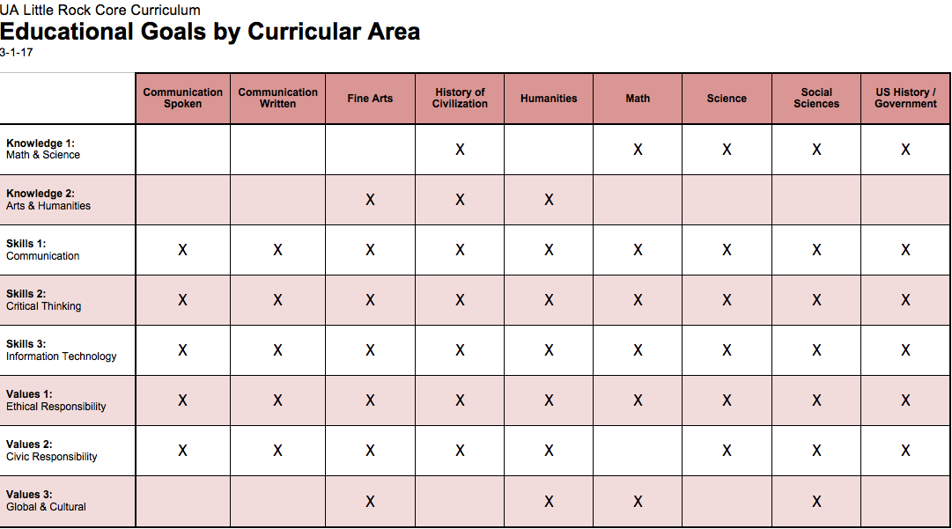
Educational Goals

Slide 9
Core Assessment Report
Methods
1. How was student work (artifacts) collected for assessment?
2. What types of artifacts were collected?
3. How were the artifacts sampled for assessment?
4. How were the artifacts scored?
5. How was reliability in scoring determined and ensured?

Slide 10
Core Assessment Report cont.
Reflection
What was learned from the assessment results?
Continuous Improvement
What changes will be made based upon the assessment results?
Feedback
What changes are recommended for Core assessment?
Comments
Other comments

Slide 11
Fine Arts-Results

Slide 12
Timeline for future
Fall 2017 –
*Report on Skills 1 (or Skills 2 for Communication Written Communication Speech) due by September 22, 2017.
*Collect data for all remaining Skills
Spring 2018-
*Report on all remaining skills- February 16, 2018
*Collect data on all values (this includes Values 1, 2, & 3)
Fall 2018-
Report on all values –due September 21, 2018
*Start of next cycle TBD

Slide 13
THANKS
Members of the Core Council
Elizabeth Sloan Davidson and Linda Stauffer , CEHP
Mark Funk and Joe Felan, COB
Nick Jovanovic and Michael DeAngelis, CEIT
Rebecca Streett and Brian Mitchell, CASL
Belinda Blevins-Knabe and Tusty ten Bensel, CSSC
Members of SKIM
Joanne Liebman-Matson, Chair
Thomas Wallace, CEIT
Julianna Flinn, CSSC
Al Adams, CALS
Carolyn Macheak, Library
Edward Anson, CALS
Jan Thomas, CALS
Kristen McIntyre, CSSC

Slide 14
Thanks…
CAAC Committees Fall 2016-Spring 2017
Science
Al Adams
Miles Blanton
Marian Douglas
Katie King
Forrest Payne
Rene Shroat Lewis
Social Science
Bob Sanderson
Jess Porter
Sarah Quintar
Eric Wiebelhaus-Brahm
Jim Hurst
Elisabeth Sherwin.

Slide 15
Thanks…
Math
Melissa Hardeman
Eric Kaufmann
Annie Childers
Marvelyn Tapp
History of Civ
Michael Heil
Thomas Kaiser
Ed Anson
US History/Gov
Kristin Mann
James Ross
Joseph Giammo
Vince Vinikas

Slide 16
Thanks…
Fine Arts
Floyd Martin
Kwasi Boateng
Kenneth Goff
Lynne Ann Ellsworth Larsen
Stacy Pendergraft
Humanities
Angela Hunter
Jeremy Ecke
Keith Robinson
Joseph Spino
Communication-Speech
Kristen McIntyre
Cheryl Johnston
Melissa Johnston
Katie Halford

Slide 17
Thanks…
Communication-Written
George Jensen
Brian Ray
Londie Martin
Special thanks
Ross Bradley
Pattie McCord
Malissa Mathis

