Slide 1
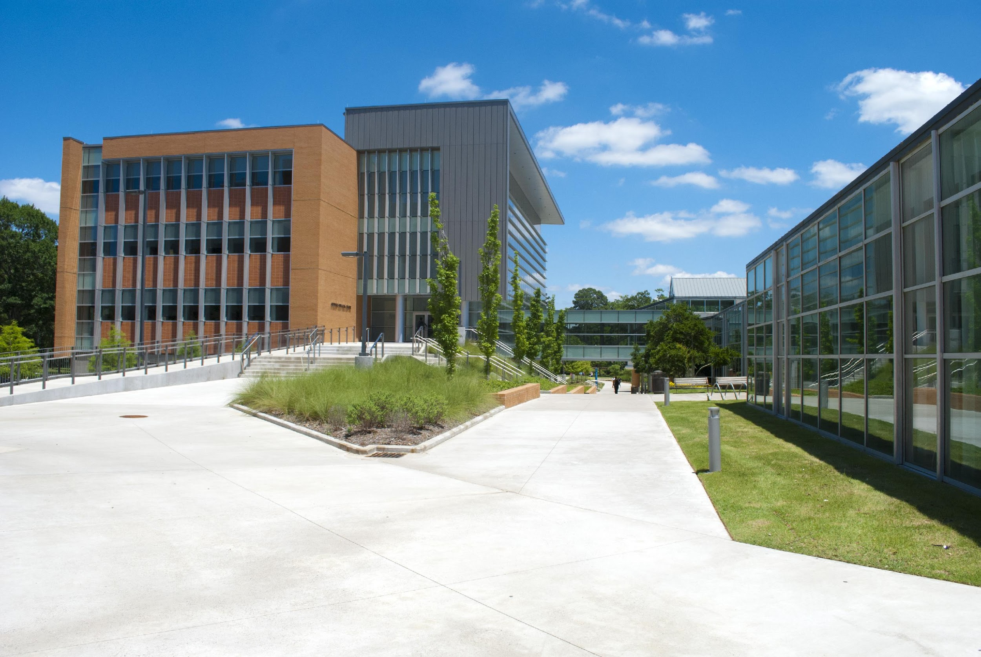
Curricular Practical Training
International Student Services
Revised April 6, 2015

Slide 2
Examples of Curricular Practical Training
Padma - Systems Engineering
Dani - Civil and Construction Management
Ming - Doctoral candidate

Slide 3
Curricular Practical Training
8 CFR 214.2(f)(10)(i)
(10) Practical training. Practical training may be authorized to an F-1 student who has been lawfully enrolled on a full time basis, in a Service-approved college, university, conservatory, or seminary for one full academic year. This provision also includes students who, during their course of study, were enrolled in a study abroad program, if the student had spent at least one full academic term enrolled in a full course of study in the United States prior to studying abroad. A student may be authorized 12 months of practical training, and becomes eligible for another 12 months of practical training when he or she changes to a higher educational level. Students in English language training programs are ineligible for practical training. An eligible student may request employment authorization for practical training in a position that is directly related to his or her major area of study. There are two types of practical training available:
(i) Curricular practical training. An F-1 student may be authorized by the DSO to participate in a curricular practical training program that is an integral part of an established curriculum. Curricular practical training is defined to be alternative work/study, internship, cooperative education, or any other type of required internship or practicum that is offered by sponsoring employers through cooperative agreements with the school. Students who have received one year or more of full time curricular practical training are ineligible for post-completion academic training. Exceptions to the one academic year requirement are provided for students enrolled in graduate studies that require immediate participation in curricular practical training. A request for authorization for curricular practical training must be made to the DSO. A student may begin curricular practical training only after receiving his or her Form I-20 with the DSO endorsement.

Slide 4
Curricular Practical Training
An F-1 student may be authorized by the DSO to participate in a curricular practical training program that is an integral part of an established curriculum…. 8 CFR 214.2(f)(10)
Establishing the Curricular Component
Enroll in a course
Co-Op, Internship, Practicum, Field Work, etc.
Required for degree completion
Required for graduation, but not a credit
Essential for research
Available only for PhD students

Slide 5
Curricular Practical Training
Practical training may be authorized to an F-1 student who has been lawfully enrolled on a full time basis… for one full academic year… 8 CFR 214.2(f)(10)
You must complete one academic year in your program of study.
CPT is the practical application of classroom theory
August to May or January to December
Restarts with new program
Restarts with new initial I-20

Slide 6
Curricular Practical Training
An eligible student may request employment authorization for practical training in a position that is directly related to his or her major area of study. 8 CFR 214.2(f)(10)
CPT must be in your field of study.
Course you’re enrolling in must be in your declared major
Minors may be approved on a case-by-case basis

Slide 7
Applying for CPT
Gather information early, apply for CPT at the very end.

Slide 8
Preliminary Eligibility
Check with ISS
Is this your second degree in the United States?
Have you had practical training before?
When do you meet the academic year eligibility?
Did you begin a new initial I-20?
Check with your Department
Do they offer academic credit for employment?
If so, what are the pre-requisites for the course?
Talk to the Office of Cooperative Education
This office helps connect students and employers
Michelle Goza can help you understand the Co-Op process, which works in tandem with CPT regulations.

Slide 9
Find a Position
Receive Job Offer Letter
On company letterhead with starting date and expected hours per week
Enroll in the Course Giving you Academic Credit
See your academic advisor to do an internship within your department OR
See the Office of Cooperative Education to do a Co-Op
Be mindful of registration and Co-Op deadlines
Submit Application for CPT to ISS
Part One: Student Application
Part Two: Advisor Approval
Part Three: Revoking Graduate Assistantship

Slide 10
Receive Notification from ISS
You only have work authorization after you have completed the process and see your new I-20 giving you with authorization
CPT Authorization is:
With a specific employer
During specific dates
For a specific amount of hours per week

Slide 11
Common Concerns
Confusing Practical Training?

Slide 12
Frequently Asked Questions
What are the dates of my CPT?
CPT authorization will follow the dates of the semester, unless the curricular reason for your CPT lies outside traditional semester dates.
Can I continue you CPT after the semester?
If you remain eligible, you must reapply each semester.
How many hours can I work per week?
Spring and fall CPT is up to 20 hours per week. Summer CPT can be up to 40 hours per week. During your last semester, with advisor permission, you can work more than 20 hours per week.

Slide 13
Frequently Asked Questions
Can I have CPT now and OPT later?
Yes, unless you use 12 months of full-time CPT. After you have done OPT at the same level, you cannot have CPT.
Can I have CPT and work off-campus?
No. You can either have authorization for CPT or on-campus employment.
How does my employer know that I have work authorization?
After your CPT has been approved, your I-20 will be updated to show the CPT authorization. Show this to the Human Resource office at your company.

Slide 14
Quick Summary
True or False
A job that will be great on your resume will qualify for CPT.
False. You must also satisfy the curricular component.
You can receive CPT after your second full semester.
True. One academic year is a fall and a spring semester.
You can apply for CPT before receiving the job offer.
False. Receive CPT authorization after the opportunity is established
Sara creates these rules to keep you from opportunities.
False! I definitely want you to have good, legal experiences.

Slide 15
Your Questions?

Slide 16
International Student Services
2801 S. University Avenue
EDU 101
Little Rock, AR 72204
internationalservices@ualr.edu
501-683-7566

