Slide 1
Instructions for I-765 and G-1145 For Standard OPT
For more OPT information and other presentations, visit
www.ualr.edu/international/opt
Revised September 10, 2014

Slide 2
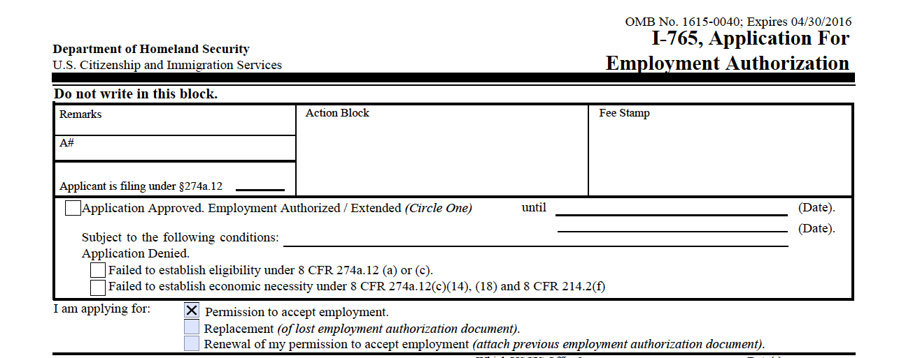
I-765 Application for Employment Authorization
This is the official application you’ll send to USCIS.

Slide 3
Instructions for Completing I-765
Follow directions on Name
PARROTT Sara Bethany
Write name according to I-20
Skip 2. if no other names have been used

Slide 4
Instructions for Completing I-765
Use a permanent address
Use the ISS address if you may move in the next 6 months
Using our address will slow down the process by 2-3 days

Slide 5
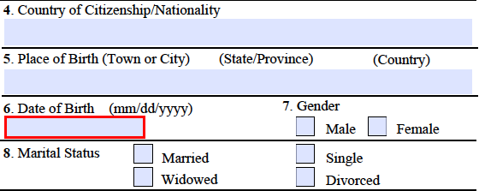
Instructions for Completing I-765
Complete 4-8 easily
Dating or engaged/betrothed = Single

Slide 6
Instructions for Completing I-765
If you have no SSN, leave blank
Use I-94 number
Available at www.cbp.gov/i94

Slide 7
Instructions for Completing I-765
Check yes only if you have had an EAD in the past.
CPT is not in mind here
If no, skip to question 12 in the second column

Slide 8
Instructions for Completing I-765
If yes, complete the second part of question 11.
Find information on previous approval notice
A DSO where you applied for the EAD can look this up in your SEVIS record

Slide 9
Instructions for Completing I-765
Check your I-94 for entry data
www.cbp.gov/i-94
Or check passport entry stamp

Slide 10
Instructions for Completing I-765
14. Latest Entry Visa
Will only be different from status (F-1) if you did a change of status within the U.S.
Otherwise: F-1 Students
15. Student

Slide 11
Instructions for Completing I-765
16. For Standard Post-Completion OPT: (C) (3) (B)
For pre-completion: (C) (3) (A)
For STEM Extension: (C) (3) (C)
Not for STEM graduates filing first OPT

Slide 12
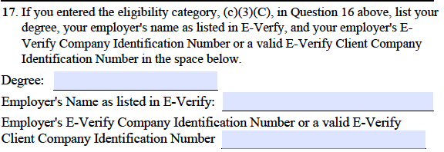
Instructions for Completing I-765
17. Only when filing STEM Extension
Not for STEM graduates filing first OPT
Degree = Major according to I-20
Ask your employer E-Verify Information
Must match the database

Slide 13
Instructions for Completing I-765
SIGN HERE
Be sure to Sign and Date
Applications without a signature will get denied
Sign between the solid lines

Slide 14
G-1145
Optional but recommended
You will receive an electronic receipt and email notifications on the status of your case

