Slide 1

Medicaid Expansion:
State Considerations & Approaches
Deborah Bachrach, Esq
Anne Karl, Esq
University of Arkansas School of Law
February 28, 2014

Slide 2
Medicaid in the ACA Coverage Continuum
100%
138%
Medicaid expansion to childless adults and parents
400%
FPL
0%
100%
200%
300%
400%
Medicaid
eligibility levels vary by state
Insurance Affordability Programs (“IAPs”)
CHIP
eligibility levels vary by state
Premium Tax Credits and Cost-Sharing
Reductions for Qualified Health Plans
Qualified Health Plans
Employer Sponsored Insurance

Slide 3



Medicaid Expansion: In State’s Hands
Expand?
How?
Don’t Expand?

Slide 4

Who Can the Expansion Cover? At What Matching Rate?
The New Adult Group
 | Under age 65
 | Income below 138% FPL
 | Not pregnant
 | Not entitled to or enrolled in Medicare Part A
 | Not in any other mandatory Medicaid eligibility group
Year | Enhanced Federal Matching Rate Newly Eligible Adults up to 138% FPL
 | State Share | Federal Share
2014 | 0% | 100%
2015 | 0% | 100%
2016 | 0% | 100%
2017 | 5% | 95%
2018 | 6% | 94%
2019 | 7% | 93%
2020+ | 10% | 90%

Slide 5




What Benefits Do New Adults Receive?
The Alternative Benefit Plan (ABP):
Must include all 10 essential health benefits (EHBs)
Must meet mental health parity
Must cover EPSDT for 19 and 20 year olds
Must cover non-emergency transportation

Slide 6
Fiscal Impact of Coverage Expansion
COSTS
SAVINGS
State share of costs for newly eligibles after 2016
Currently eligibles stepping forward for coverage (some of this may happen due to ACA in any case)
Administrative costs of a larger program
Moving current Medicaid populations into new adult group (e.g. pregnant women, medically needy and waiver populations), for which state receives enhanced matching rate
Replacing state funding for programs for the uninsured (e.g. high risk pool, substance abuse/mental health programs) with Medicaid funds
Provider Taxes/Assessment
Plan Taxes/Assessment
REVENUE

Slide 7
Medicaid Expansion Decisions for 2014
Washington
Montana
North Dakota
Minnesota
Vermont
Maine
Oregon
Idaho
Wisconsin
New Hampshire
South Dakota
Massachusetts
Wyoming
Michigan
New York
Rhode Island
Iowa
Connecticut
Nevada
Nebraska
Pennsylvania
New Jersey
Ohio
Delaware
Utah
Indiana
Illinois
California
Colorado
West Virginia
Maryland
Kansas
Missouri
Virginia
Kentucky
Tennessee
North Carolina
Arizona
New Mexico
Oklahoma
Arkansas
South Carolina
Georgia
Moving Forward at this Time (25 + DC)
Alaska
Texas
Florida
Not Moving Forward at this Time (24)
Hawaii
Louisiana
Alabama
Mississippi
Waiver Pending (1)
  64% of Uninsured Live in Non-Expansion States and About 4.8 Million will Fall Into Coverage Gap
Source of Uninsured Data: Urban Institute and Kaiser Family Foundation

Slide 8
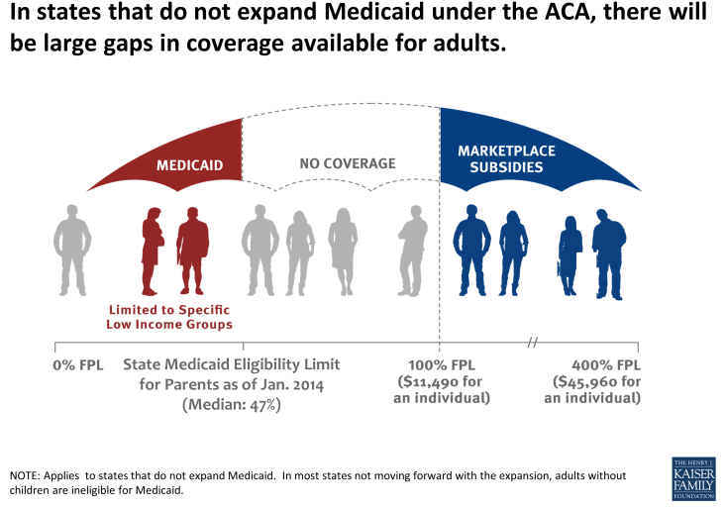
Non-Expansion States: The “Coverage Gap”

Slide 9
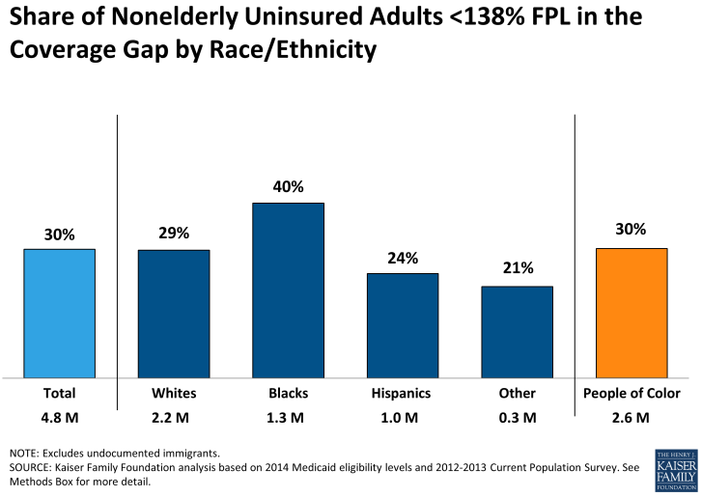
Who Is In the Coverage Gap?
4.8 million uninsured adults fall in the coverage gap
2.6 million (over half) are people of color
8.7 million people of color are uninsured and below 138% FPL. 30% of these individuals (2.6 million) fall in the coverage gap

Slide 10
Emerging Approaches to Coverage Expansions

Slide 11
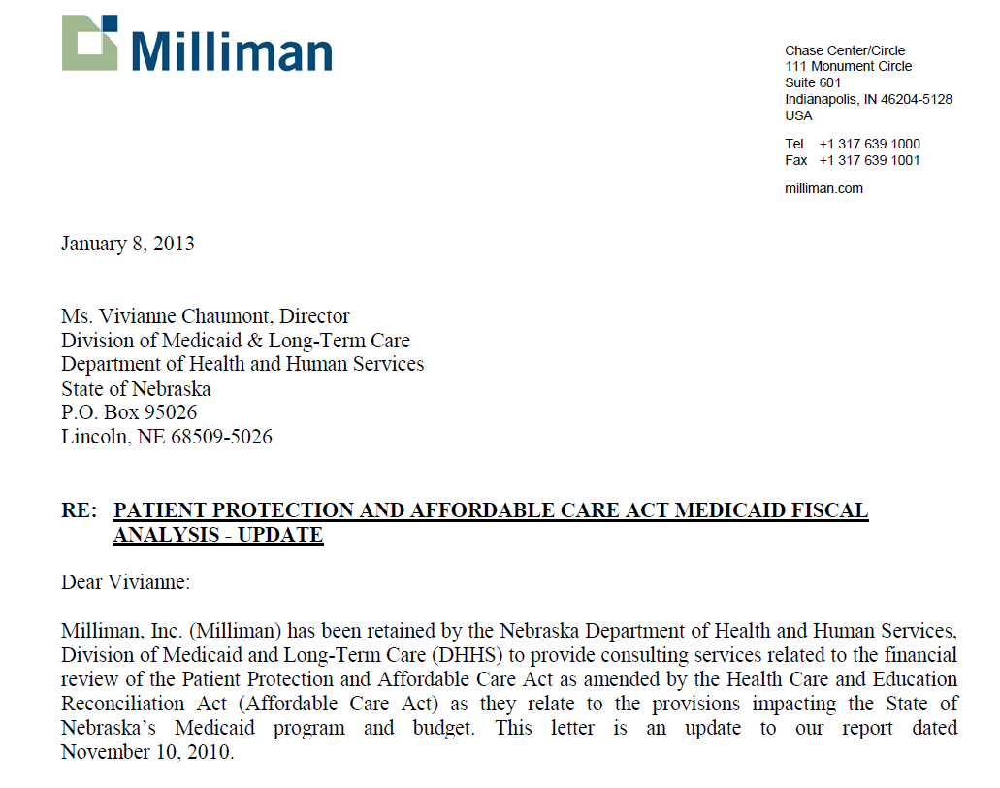
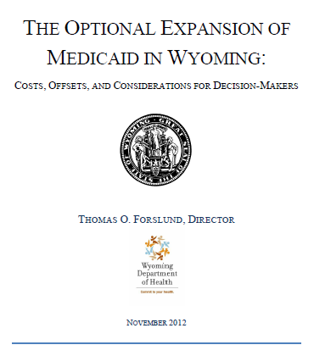
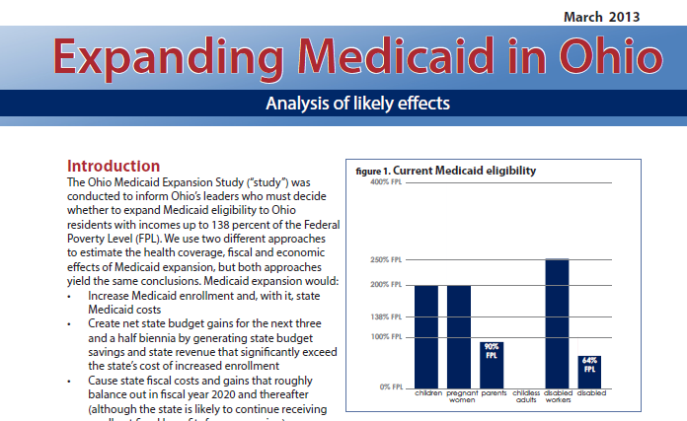
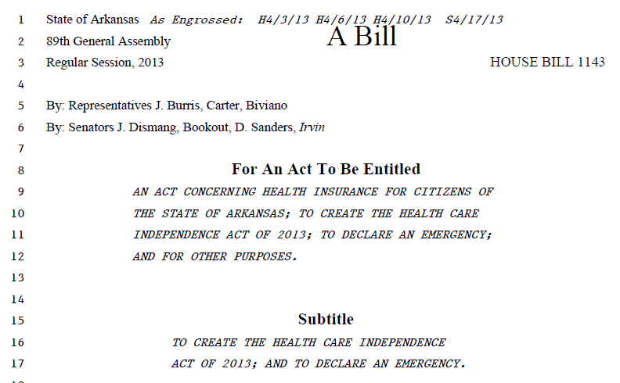
States Are Considering Medicaid Expansion Options

Slide 12


Dynamic Federalism
MEDICAID
STATES
HHS

Slide 13



States are Exploring Alternative Coverage Models
Non-expansion states remain under pressure from powerful stakeholders
including hospitals, chambers of commerce and local governments
States are seeking their own expansion pathways
  Premium Assistance for Employer Sponsored Insurance (ESI). To prevent Medicaid-eligible adults from dropping ESI, Medicaid programs will wrap around premiums, cost-sharing and benefits. (SSA § 1906)
  Premium Assistance in the Marketplace. Medicaid buys QHP coverage for the expansion adults.
  Arkansas and Iowa have obtained federal approval to move forward with this approach. (42 CFR § 435.1015)
  Premiums and Cost-Sharing. States are increasingly looking to require co-payments and premiums, seeking federal waivers where necessary.
  Health Incentives. States are seeking to incent healthy behaviors by forgiving co-pays and/or premiums to meeting certain health standards.

Slide 14




Medicaid Premium Assistance:
For Employer Sponsored Insurance
Iowa will use mandatory Premium Assistance for Medicaid eligible individuals with access to ESI
(in addition to Premium Assistance in the Individual Market for 100-133% FPL)
ESI Coverage
Employer
Medicaid
New Hampshire’s Medicaid Expansion Study Commission recommended mandatory Premium Assistance for Medicaid eligible individuals with access to ESI
(in addition to Premium Assistance in the Individual Market for 100-133% FPL)
Wraps benefits and covers consumer’s premiums and cost-sharing beyond
Medicaid limits

Slide 15

Medicaid Premium Assistance:
In the Individual Market
In 2014 Arkansas will purchase coverage for all childless adults and parents 17-133% FPL through QHPs in the Marketplace
QHP Coverage
Medicaid
Iowa will purchase coverage for newly eligible adults 100-133% FPL through QHPs in the Marketplace
Purchases QHP coverage for Medicaid eligible new adults
Covers cost of premiums
Wraps missing benefits and excessive cost-sharing
Pennsylvania has proposed purchasing coverage for all newly eligible adults through QHPs in the Marketplace

Slide 16
Medicaid Premium & Cost-Sharing Rules
 | < 100% FPL | 100% - 149% FPL | ≥ 150% FPL
Maximum Allowable Medicaid Premiums and Cost-Sharing
Aggregate Cost-Sharing Cap | 5% household income | 5% household income | 5% household income
Premiums | Not allowed | Not allowed | Permitted, subject to aggregate cap
Maximum Service-Related Co-pays/Co-Insurance
Outpatient services | $4 | 10% of cost the agency pays | 20% of cost the agency pays
Non-emergency ER | $8 | $8 | No limit
Rx Drugs | Preferred: $4 Non-Preferred: $8 | Preferred: $4 Non-Preferred: $8 | Preferred: $4 Non-Preferred: 20% of cost the agency pays
Institutional | $75 per stay | 10% of total cost the agency pays for the entire stay | 20% of total cost the agency pays for the entire stay
Specific populations are exempt from cost-sharing requirements (e.g., pregnant women, spend-down beneficiaries, and individuals receiving hospice). However, exempt individuals may be charged cost-sharing for non-preferred drugs and
non-emergency use of the emergency room
Cost sharing cannot be mandatory for individuals with household incomes < 100% FPL
If non-preferred drugs are medically necessary, preferred drug cost sharing applies
Source: SSA § 1916 and 1916A

Slide 17







Emerging Approaches to Personal Responsibility
INVOICE
INVOICE
Visit to Clinic | $8
Behavioral Health Outpatient Visit | $4
Generic Rx | $4
Name brand Rx | $8
Inpatient/per day | $140
Premiums?
Health Incentives?
Work Referral?
Work Requirements?

Slide 18
Comparison of State Waivers for New Adults
 | Premium Assistance for QHPs | Cost-Sharing | Premiums | Healthy Behavior & Work Incentives | Benefits
Arkansas | Yes All childless adults 0-133% FPL Parents 17-133% FPL | Yes 100-133% FPL in year one Wide range of services | No | No (in year one) Any healthy behavior incentive programs will be established through QHPs | All benefits covered under the Alternative Benefit Plan
Iowa | Yes All adults 100-133% FPL | Yes 100-133% FPL only Limited to non-emergency use of the ER | Yes 100-133% FPL only Up to 2% of income Payment is not a condition of eligibility | Yes May reduce premium obligations | All benefits covered under the ABP except non-emergency medical transportation (NEMT). NEMT waived for one year.
Michigan | No | Yes Childless adults 0-133% FPL Parents 55-133% FPL Wide range of services | Yes 100-133% FPL only 2% of income Payment is not a condition of eligibility | Yes May reduce premium and cost-sharing obligations | All benefits covered under the Alternative Benefit Plan
Pennsylvania (pending submission) | Yes All childless adults 0-133% FPL All parents 33-133% FPL | Yes 0-133% FPL Limited to non-emergency use of the ER | Yes 50-133% FPL only Up to $25 per month for one adult or $35 per month for more than one adult (> than QHP premiums) | Yes May reduce premium obligations Includes work requirements | Requests waiver of requirement to provide benefits beyond those covered by qualified health plans (e.g., FQHCs, NEMT)

Slide 19



Expansion, Reform & Simplification Work Together
Coverage Expansions
Payment & Delivery Reform
Administrative Simplification

Slide 20
Medicaid Payment & Delivery Reform
Medicaid is becoming a more sophisticated purchaser, and states are using:
  Coordinated care models (ex: patient centered medical homes, health homes)
  Outcomes-based incentives (ex: pay for performance)
  Value-driven reimbursement (ex: bundled payments)
  Continued penetration of Medicaid managed care, to more populations and with a broader range of benefits
States are motivated by pressure to reduce state expenditures, the availability of federal funding and momentum toward improving quality of care
States may use 1115 waivers to take advantage of flexibilities:
  To craft alternatives to Medicaid expansion
  To create “Delivery System Reform Implementation Pools” (funding pools)
  To reform long-term care systems
  To make sweeping, innovative changes to state health care systems (via State Innovation Model grants)

Slide 21
THANK YOU
Deborah Bachrach, Esq.
Partner
Manatt, Phelps & Phillips
Dbachrach@manatt.com
Anne Karl, Esq.
Associate
Manatt, Phelps & Phillips
Akarl@manatt.com

