Slide 1
Ad hoc Committee on Online Education
Status Report: Dec 5, 2014
"The good news is that there are many faculty at UALR
who are already successfully teaching online using
best practices, some in fully online programs."

Slide 2
Members
Belinda Blevins Knabe Psychology
Vickie Edwards IOG
Jennifer Holtz CARE
James Golden Criminal Justice
Cynthia Johnson Accounting
Denise LeGrand Mathematics
Karen Leonard Management
Carolyn Macheak Library
Lisa Sherwin Psychology

Slide 3
Charge
To articulate an online endeavor for UALR that is a good fit for this university that is based on best practices and latest research.
To outline the creation of such a program over the course of 5 years.
To prioritize the stages in the process.

Slide 4
Update
Polled faculty
Reviewed successful programs
Piloting a preparedness questionnaire

Slide 5
Polling Faculty
On Nov 25th, an email went out via FacFocus asking faculty to forward their thoughts on what they wish their students knew before they took an online course

Slide 6
5 top themes
Online learning requires:
Self-discipline, time management skills, motivation
Access to dependable internet
Willingness to participate and reach out to others
Awareness that online is not easy or easier
Blackboard savvy

Slide 7
Successful Online Programs
ASU
Colorado Global
Western Governors
U of Wilmington
U of Maryland
Southern New Hampshire

Slide 8
Similarities
Serve both traditional and non-traditional students
Tuition and fees same as, or lower (or appear so), than f2f
Immediate and consistent contact and support at registration and during enrollment
Smooth interface with university (enrollment, course registration, financial aid)

Slide 9
Very rich websites with support information (including fit and expectations)
24/7 tech support (at least)
Often have student mentors, coaches etc.
Faculty with terminal degrees
Small classes (17- 35 students, most ~ 20)
Multiple formats (hybrid, fully online and f2f w online)
Classes in 15 or 7 week formats (carousel scheduling).

Slide 10
Idiosyncratic
Focus on military
Multiple start dates in each semester
Competency based learning

Slide 11
Seeking
Faculty to participate in testing a preparedness questionnaire in Spring semester

Slide 12
Questions?

Slide 13
Ad hoc Committee on Online Education
Status Report: Nov 14, 2014

Slide 14
Members
Belinda Blevins Knabe Psychology
Vickie Edwards IOG
Jennifer Holtz CARE
James Golden Criminal Justice
Cynthia Johnson Accounting
Denise LeGrand Mathematics
Karen Leonard Management
Carolyn Macheak Library
Lisa Sherwin Psychology

Slide 15
Charge
To articulate an online endeavor for UALR that is a good fit for this university that is based on best practices and latest research.
To outline the creation of such a program over the course of 5 years.
To prioritize the stages in the process.

Slide 16
Mission Statement
UALR’s faculty and staff are committed to creating and providing quality, cutting-edge, online education.
It will be faculty led, learning centered, and fiscally responsible.
Faculty and staff will empower students through online educational experiences that prepare them to be productive citizens and to pursue life long learning..

Slide 17
Mission Statement
UALR’s faculty and staff are committed to creating and providing quality, cutting-edge, online education.
It will be faculty led, learning centered, and fiscally responsible.
Faculty and staff will empower students through online educational experiences that prepare them to be productive citizens and to pursue life long learning..

Slide 18
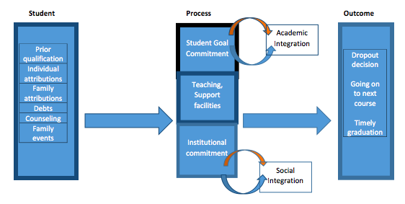
Our Model for Student Success in Online Learning
(adapted from Tinto, and Horn)

Slide 19
Seeking
Faculty who are interested in piloting a preparedness questionnaire in Spring 2015.
If interested, please contact ebsherwin@ualr.edu before the end of November so we can talk (and get IRB documents ready…..)

