Slide 1
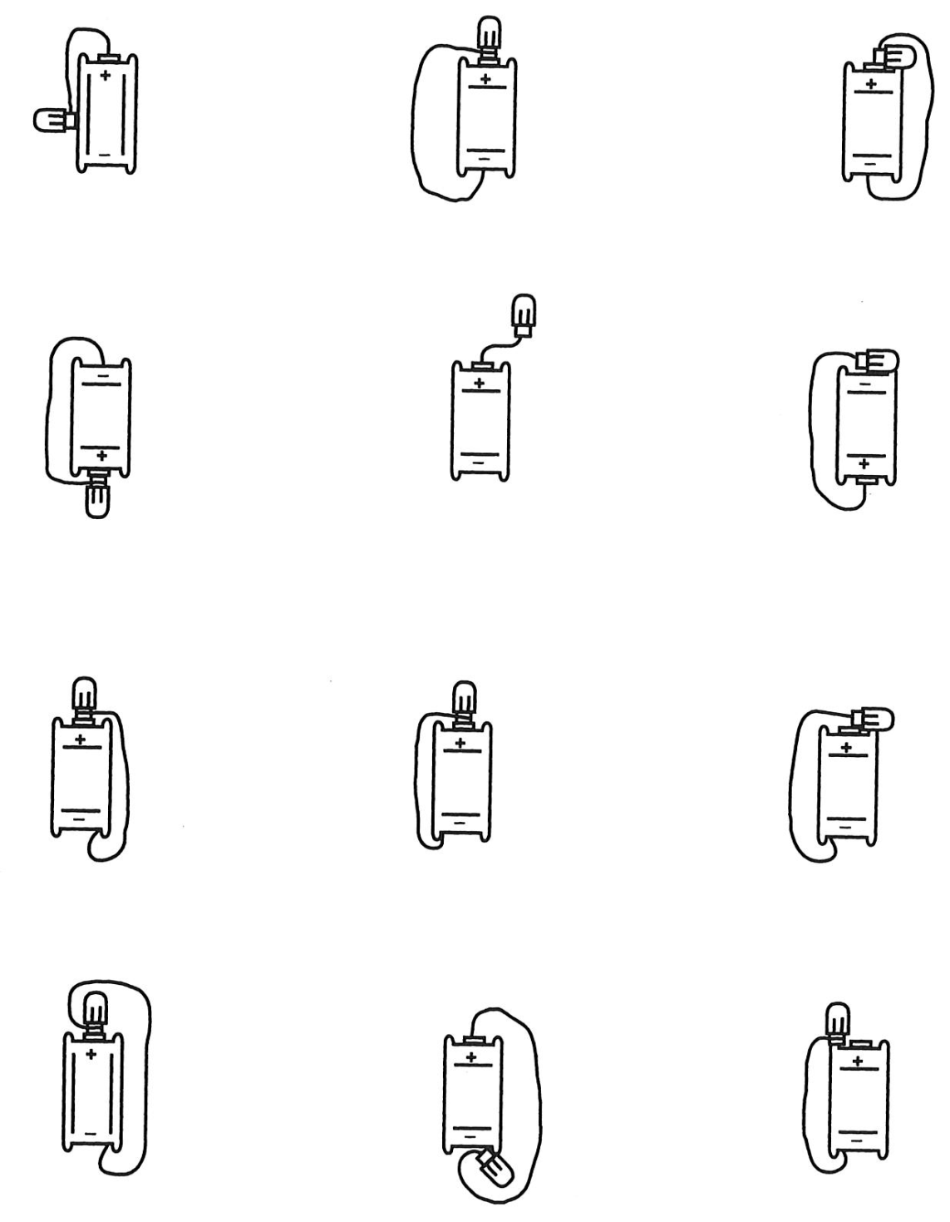
Which of these were complete circuits?
What does it mean to complete a circuit?
How does this activity prepare you to design a public building with power requirements?

Slide 2
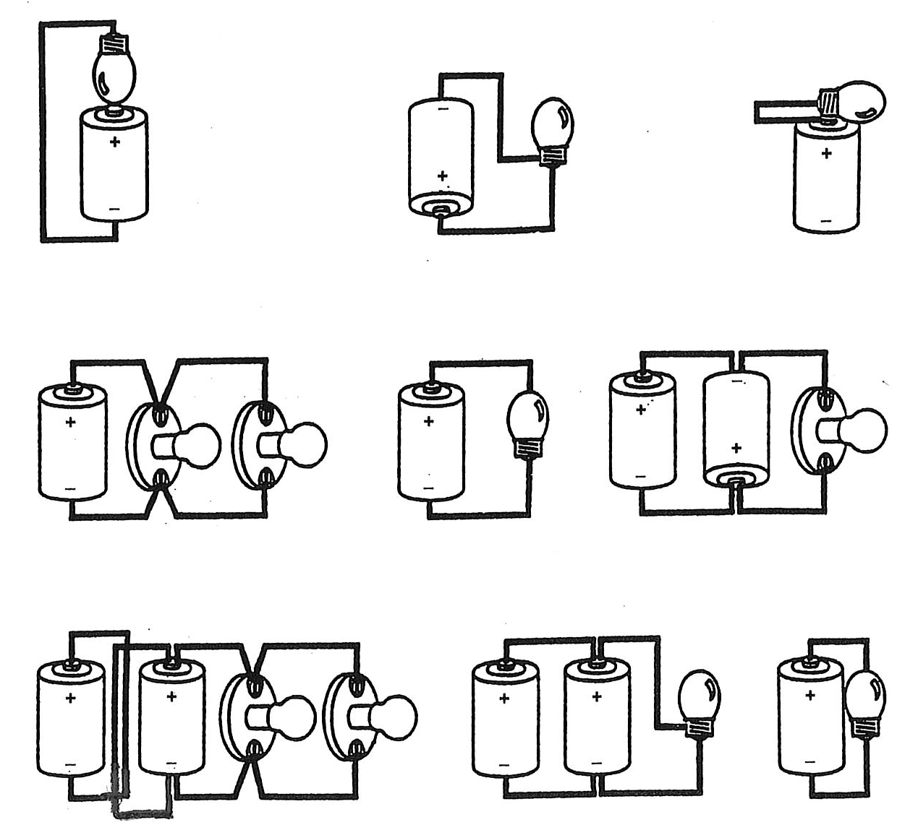
Which of these were complete circuits?
How does this activity prepare you to design a public building with power requirements?

Slide 3

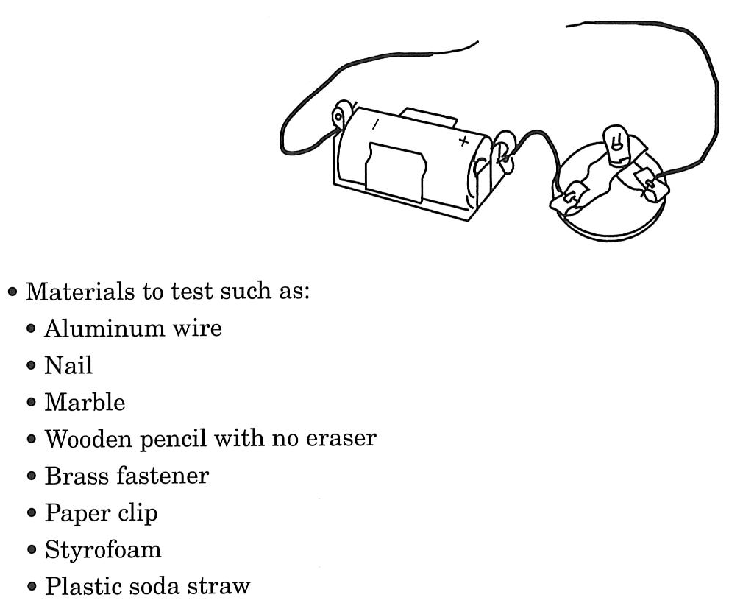
Which items made the bulb light? Why did the bulb light with certain items but not with others?
How does electricity travel?
How does this activity prepare you to design a public building with power requirements?

Slide 4
Table of Contents and Heading: Date:
Question(s):
How does length of wire in a circuit affect brightness of the bulb? How does number of batteries in a circuit affect brightness of the bulb? How does number of bulbs affect the brightness of the bulbs?
Prediction:
If _______________ then ___________________ because ______________________________.
Materials:
Data/Observations:
Claims and Evidence:
Conclusion:
Turn the question or prediction/hypothesis into a statement to be used as a topic sentence. Support your topic sentence with 3/5 supporting statements to create a paragraph.
WOW/Wonderings:
What do you WONDER now?

Slide 5
What did you learn from your experiment that will be useful in wiring your model? Explain why that information will be useful.
Draw a picture of your experimental setup.
  Label its boundaries and its elements.
  List the input and the output that came out of your experimental system.
What interactions inside the system allow it to produce output?
Were there interactions between the original system elements or interactions with input that you added?

Slide 6
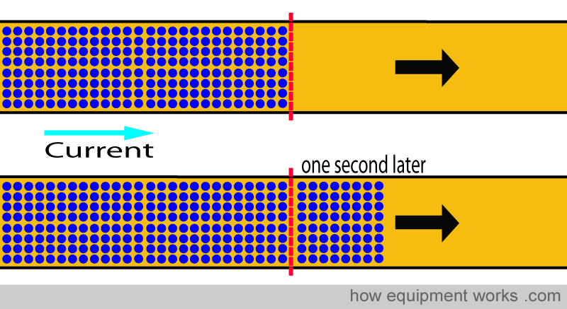
CURRENT- number of electric charges that pass through a particular place in the circuit in a given amount of time.

Slide 7
Complete AC/DC activity on page 109.

Slide 8
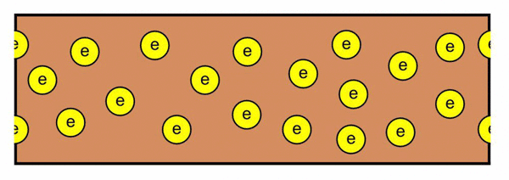
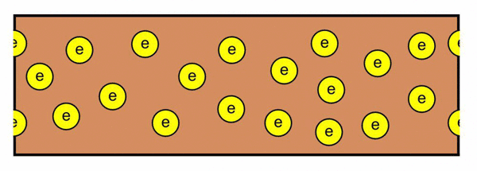
AC/DC Know-How
Electrons moving through a wire can move continuously in the same direction, or they can repeatedly reverse direction.
When electrons always flow in the same direction, the current is called direct current, or DC. Electricity from batteries is direct current.
When electrons move back and forth, reversing their direction regularly the current is called alternating current, or AC. The electricity in your home is alternating current. In fact, the current in your home changes directions 60 times every second.
Although direct current serves many purposes, alternating current is better for transporting the huge amounts of electricity required to meet the needs of a building or city.

Slide 9
Complete SCALE ACTIVITY with matchbox car and black construction paper.

Slide 10
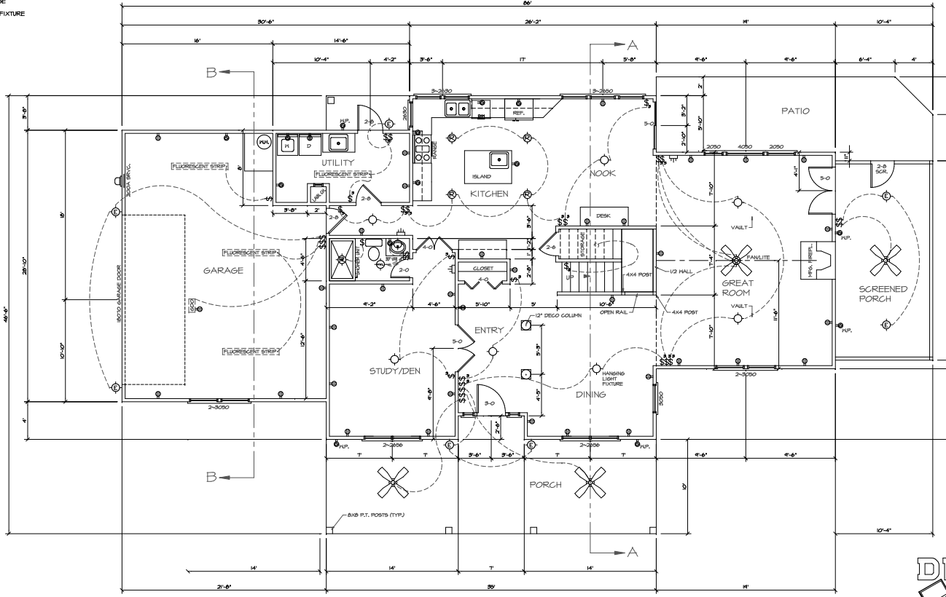
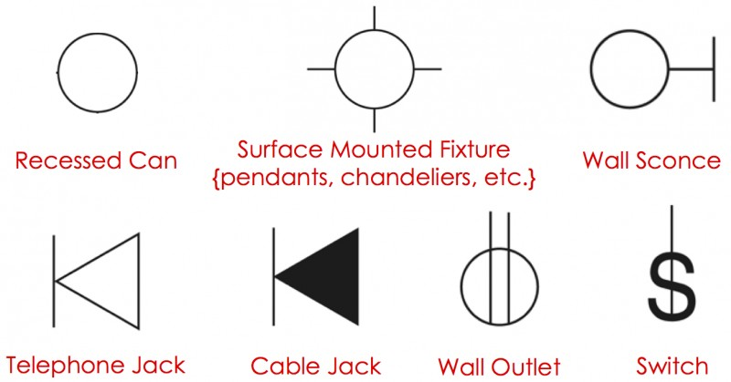
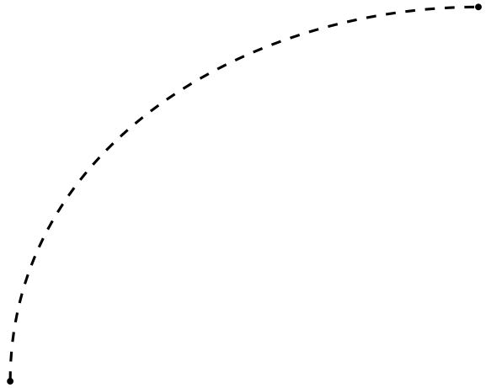
Receptacle
Ceiling mounted light fixture
Connection line
Can you use this floor plan and the symbols to determine the general and specific electrical needs of this structure?

Slide 11
ANALYSIS OF FLOOR PLAN BEFORE ADDING ELECTRICAL NEEDS
What are the general electrical needs of your building?
How can you indicate that on a floor plan?
Are the electrical needs consistent across the building or do different sections have different needs?
What are the specific needs of the building?
Will the sub-systems interactions inhibit one another? Explain.

Slide 12
Questions AFTER the Electricity Requirements Are Added to the Floor Plan
Does your electrical plan include all the electricity you want in your model? If not, what did you leave out? Why?
What symbols did you use in your key to explain the parts of your electrical plan?
Is everything on your plan clear and well labeled? Could someone else read and interpret your plan? What makes the plan especially clear?
How could you determine the length of wire needed to reach each part of the room?
How does the strength of the batteries affect your design? How many bulbs can you light from the different kinds of batteries you have used so far?
How can you make the electrical plan as efficient as possible while minimizing the costs?

Slide 13
Problem Log on Your Completed Floor Plan
Look at the different areas of your floor plan. What challenges would you anticipate based on the physical location?
What special accommodations might you have to make for special conditions?
How do high and low traffic areas differ in their demands for electricity?
How could you determine the length of wire needed to reach each part of the room?
How does the strength of the batteries affect your design? How many bulbs can you light from the different kinds of batteries you have used so far?
How can you make the electrical plan as efficient as possible while minimizing the costs?

Slide 14
MATERIALS PLANNING SHEET
For what purposes are you actually using electricity in your model?
In order to meet those needs what quantities of the following materials will you need?
  Wires
  Bulbs
  Bulb holders
  Generator
  Power source
  Clips
  Switches
  What else?
How did you decide the quantities of these materials you will need?
Build your model.

