Slide 1
LIGHTING SYSTEM DESIGN CHALLENGE

Slide 2
ASK
What is the problem?
What do you need to know before you start?
What science content have you learned that will help you with your design?

Slide 3
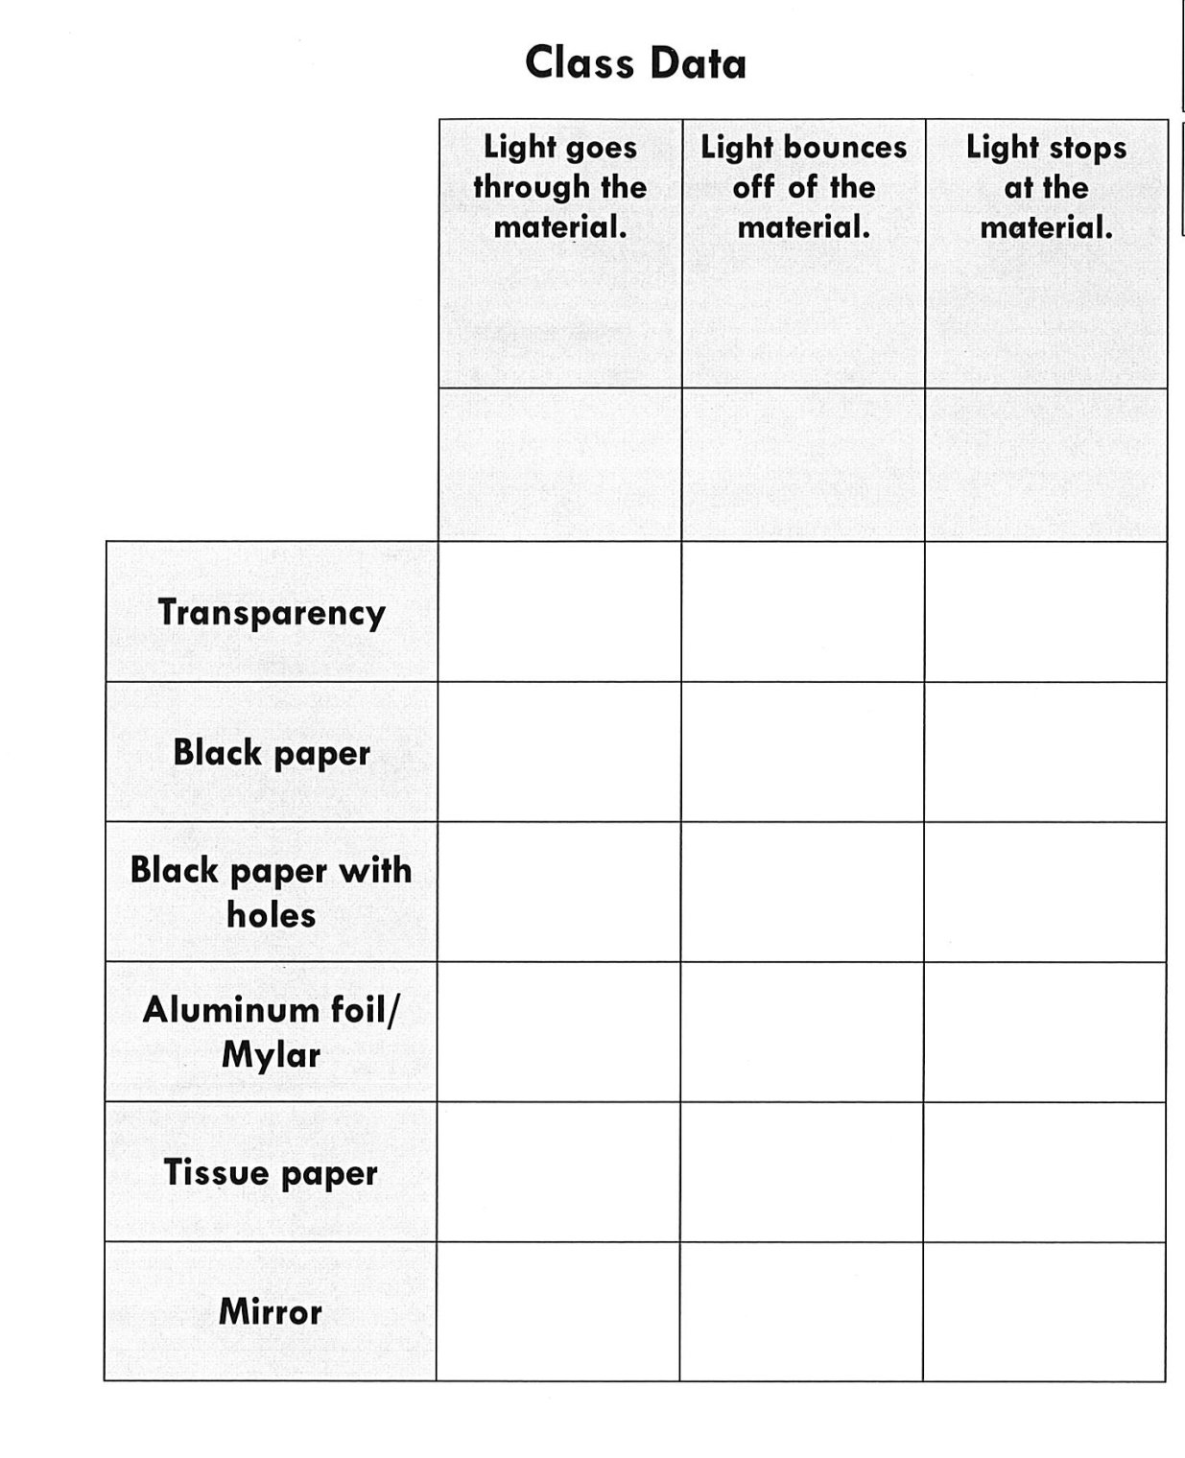

How will this information help us with our design challenge?

Slide 4
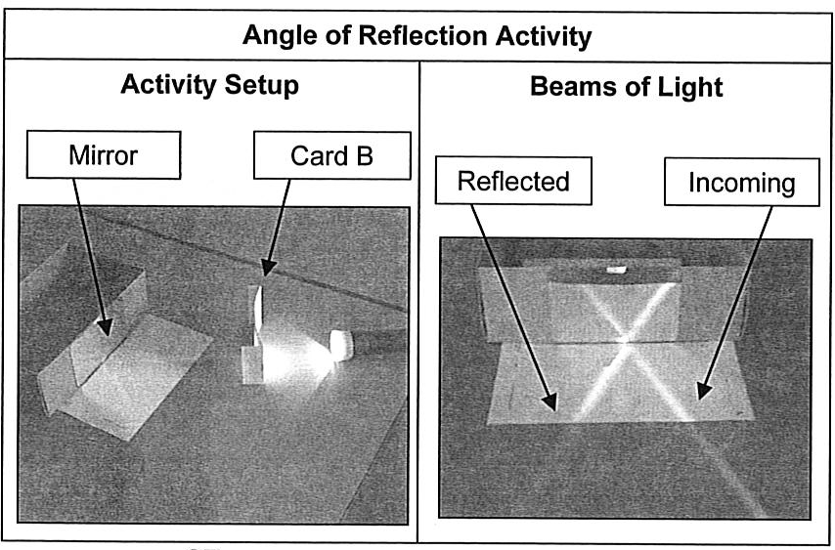
How will this information help us with our design challenge?

Slide 5
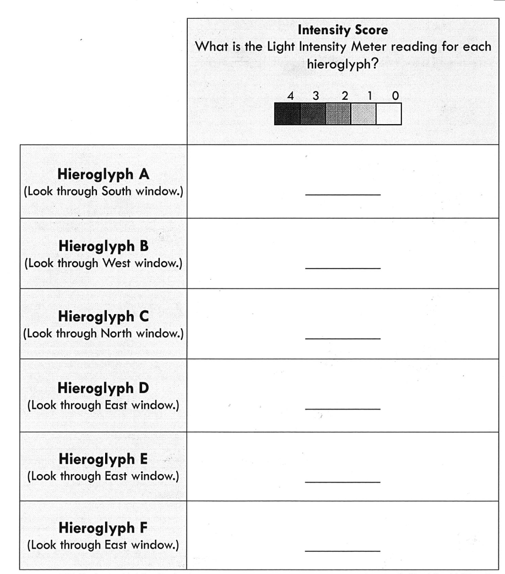
How will this information help us with our design challenge?

Slide 6
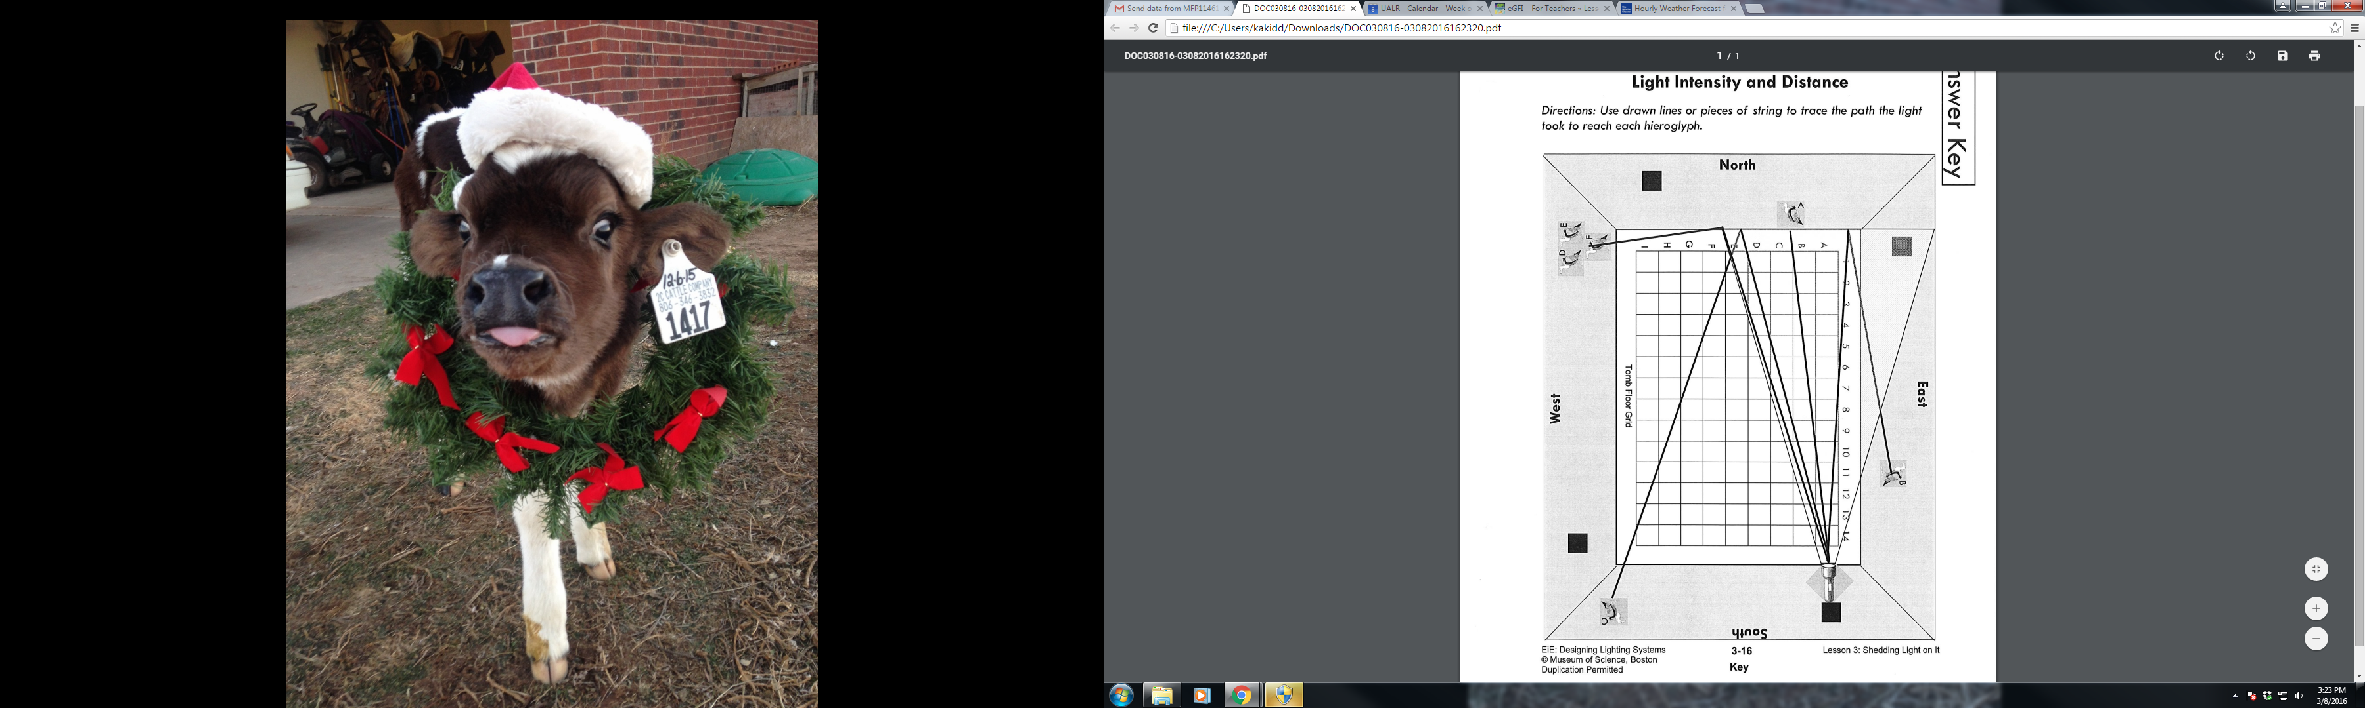
How will this information help us with our design challenge?

Slide 7
Goal- Design a lighting system for the inside of a tomb.
Criteria | Constraints
We need to light up as many hieroglyphs as possible. We need to see the eye of each hieroglyph. | There is only one light source. The light is an incandescent bulb- not as bright as an LED. The tomb can not be changed- you can’t change its size, cut openings, or move the hieroglyphics. Cost should be low.

Slide 8
