Slide 1
What do you know about plants?

Slide 2
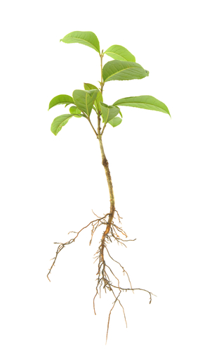
Is it food for a plant?
Sunlight
Fertilizer
Soil
Sugar
Water
Oxygen
Carbon dioxide
Notes:
None of that is food for plants. Plants make their OWN food. Plants do use water, and carbon dioxide to make that food.
Official statement from Uncovering Student Ideas in Life Science, volume 1:
“Plants take in carbon dioxide through their leaves and water through their roots and use energy from sunlight to break apart and reassemble these molecules into a carbohydrate in the form of a simple sugar.”

Slide 3
Plants make their own food- sugar.
Plants USE sunlight to change carbon dioxide and water into food. The process is called photosynthesis.
The oxygen is released by the plant during this process.
To be considered a food the substance must contain energy that can be released. Soil and minerals (fertilizer) are nutrients but not food.

Slide 4
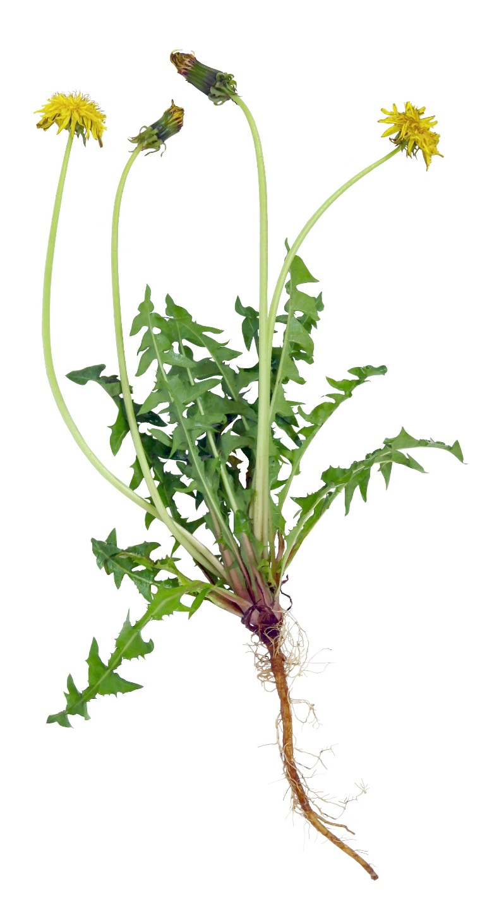
What are the parts of a plant?
What is the function of each part?
Notes:
Roots- anchor the plant and take in water
Stem- carry water to leaves and food to entire plant; provide support for the plant
Leaves- use water, carbon dioxide and sunlight to make food for the plant
Flower- to make seeds; it is the reproductive system of the plant
Seeds- baby plant

Slide 5
Flower- where new plants (seeds) form
Stem- provides support and highway for food and water
Leaves- where the food (sugar) is made
Roots- anchor the plant and absorbs nutrients

