Slide 1
Conduct Water Flow Investigation
https://www.youtube.com/watch?v=yJdO6TrJFPY
https://www.youtube.com/watch?v=yCX7r4c9N9c

Slide 2
Problem Log Questions on Flow Rate
Why would it be important to know the flow rates of the river and of the dripping liquid in the problem?
How do weather and climate affect flow rate? How might weather, climate, and the season affect our problem?

Slide 3
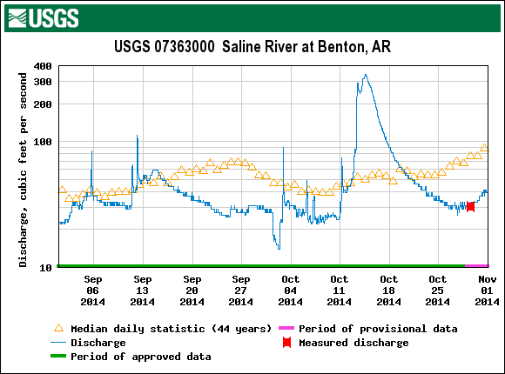

Slide 4
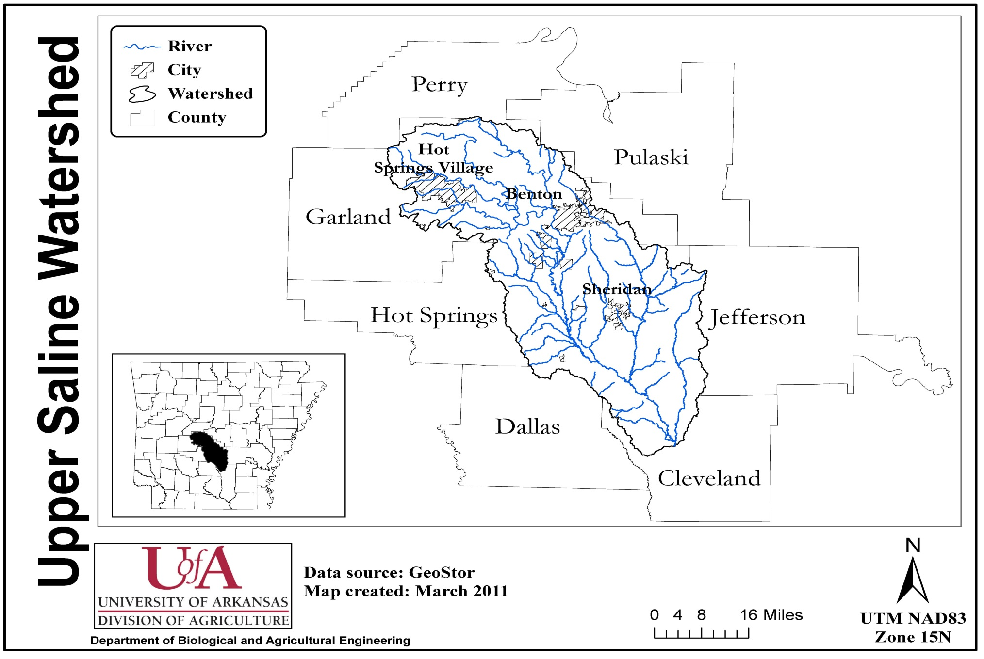

Slide 5
The Saline River rises north of Benton in the Ouachita Mountains and is formed by four forks that converge near Riverside in Saline County.
The South Fork is thirty-eight miles long and is the only one not wholly formed in Saline County.
The Middle Fork is thirty-seven miles long, and its banks are a paradise of wildflowers.
Alum Fork is sixty-one miles long and is a dramatic stream, flowing at the base of towering cliffs.
North Fork is the shortest at twenty-nine miles.
The Saline River meanders through Saline, Grant, Dallas, Cleveland, Bradley, Drew, and Ashley counties before it empties into the Ouachita River.
Among the communities located near the river are Haskell (Saline County), Traskwood (Saline County), Prattsville (Grant County), Farindale (Dallas County), Staves (Cleveland County), Rison (Cleveland County), Warren (Bradley County), and Longview (Ashley County).

Slide 8
John Thurston
Executive Offices: State Capitol Building
500 Woodlane Street, STE 109
Little Rock, AR 72201
Dear Students:
I have heard from the principal of your school that you are interested in the events which occurred on the Highway 5/ North Fork River bridge. When I was a small boy growing up in Saline County, science fascinated me. However, I chose to study law when I entered college.
I am eager to support you in your efforts to find a solution to the problems at North Fork, so I have provided a small sample of the river water at the spill site for you to test. If you discover a cost-saving way to keep the ecosystem at North Fork from deteriorating, I would be most anxious to hear from you.
Please tell your family to remember me when they go to vote next fall.
Sincerely,
Commissioner John Thurston

Slide 9
Acids and Bases
Acid: a group of chemical substances that have similar properties when dissolved in water. Some of the properties they share are sourness and the ability to dissolve metals and conduct electricity. Acids include the numbers 1-6 on the pH scale.
Base: a group of chemical substances that have similar properties when dissolved in water. Some of the properties they share are bitterness, slipperiness or oiliness, and the ability to conduct electricity. Another word for base is alkali. Bases include the numbers 8-14 on the pH scale.
Neutral: a 7 on the scale; balanced

Slide 11
Predict whether each item will be an acid or a base. YOU MUST PREDICT FOR ALL SUBSTANCES BEFORE STARTING.
Dip an indicator strip half way into the cup labeled vinegar.
Pull out strip and compare it to the indicator chart.
Record the color you see in the cup and the pH number that matches that color.
Write whether the substance is an acid, a base, or a neutral based on the number.
Repeat steps 2-5 with each substance listed below.
Substance tested | Prediction: Acid, Base, or Neutral? | Color with pH indicator | pH number according to scale | Results: Acid, Base, or Neutral?
Vinegar
Tap water
Liquid soap
Lemon juice
Baking soda solution
Shampoo
Antacid
Cream of tartar
Ammonia
River sample

Slide 13
Substance tested | Prediction: Acid, Base, or Neutral? | Color with pH indicator | pH number according to scale | Results: Acid, Base, or Neutral?
Vinegar |  |  | 2
Tap water |  |  | 6- can be 6.5 to 9.5
Liquid soap |  |  | 10
Lemon juice |  |  | 2
Baking soda solution |  |  | 9
Shampoo |  |  | 7- can vary from 3.5 to 9
Antacid |  |  | 9
Cream of tartar |  |  | 4
Ammonia |  |  | 11
River sample |  |  | 4

Slide 14
Problem Log Questions on Acids and Bases
Describe in your own words what the pH scale measures.
What substance was the most basic?
Were there any pH neutral substances?
Did any of the results surprise you? Why?
What was the most significant outcome of today’s investigation?
Is this knowledge in any way useful in the investigation of the spill? Why? How might this knowledge be used?
How do you think the pH of an acid can be altered or changed?

