Slide 1
Does Acid Affect Plants?
How does acid affect plants? How does strength of acid solution affect number of radish seeds to sprout?
Prediction:
Independent variable:
Dependent variable:
Procedure:
Place 10 radish seeds on a wet paper towel in a zipper bag. Mist the seeds with the 0% vinegar solution daily for 14 days. Observe the number of seeds that sprout during that time.
Place 10 radish seeds on a wet paper towel in a zipper bag. Mist the seeds with the 10% vinegar solution daily for 14 days. Observe the number of seeds that sprout during that time.
Place 10 radish seeds on a wet paper towel in a zipper bag. Mist the seeds with the 50% vinegar solution daily for 14 days. Observe the number of seeds that sprout during that time.
Place 10 radish seeds on a wet paper towel in a zipper bag. Mist the seeds with the 100% vinegar solution daily for 14 days. Observe the number of seeds that sprout during that time.
Results:

Slide 2
The Effect of Acid on Various Materials
How does acid affect the following materials: asphalt, concrete, fabric, metal, plastic, leaves?
Prediction:
Procedure:
Immerse each sample material in a vial of vinegar. Observe each material daily for 10 days and record observations each day.
After 10 days remove the materials from the vinegar and rinse each material. Compare the materials that have been immersed in the acid to untreated samples of the same materials.

Slide 3
Table of Contents and Heading: Neutralizing Vinegar Date:
Question(s): Can adding baking soda to vinegar change the pH of vinegar? If so, how much baking soda is needed to raise the pH of vinegar to a 7?
Prediction:
If ___________________________ then __________________ because ______________________.
Materials:
Data/Observations:
Claims and Evidence:
Conclusion:
Turn the question or prediction/hypothesis into a statement to be used as a topic sentence. Support your topic sentence with 3/5 supporting statements to create a paragraph.
WOW/Wonderings:
What do you WONDER now?
Claims | Evidence
Honey was the densest liquid. | The honey sunk to the bottom of the other liquids.

Slide 4
Procedures for Neutralizing Vinegar (an acid)
Vinegar is neutralized when it reaches a pH of 7.
Measure 5 milliliters of vinegar into a plastic cup. Take the pH of the vinegar and record your number.
Add 1 milliliter of baking soda solution to the vinegar. Stir and take the temperature of the mixture.
Use a pH strip to test and record the pH of the mixture.
Repeat steps 2 and 3 until the pH of the vinegar reaches 8.
Graph your results.
Mixture | pH number
Vinegar only
Vinegar plus 1 mL of soda solution
Vinegar plus 2 mL of soda solution

Slide 5
Problem Log Questions on Neutralizing an Acid
How does the information gained from this experiment help clarify or offer a solution to the problem?
What did you notice about the temperature of the vinegar solution as you added a base to it? What outputs will likely occur by adding a base to the spill?
The acid in the spill is much more concentrated than the vinegar used in the class. What does that suggest about the amount of base needed to neutralize the acid spill?
Would it be safe to clean up the acid spill by adding a base to it? Why or why not?

Slide 6
Diluting an Acid
How much water is needed to dilute vinegar?
Prediction:
Independent variable:
Dependent variable:
Procedure:
Measure 1 ml of vinegar into a plastic cup.
Add 1 ml of water to the vinegar.
Stir and take the temperature of the solution.
Test the pH of the solution in the cup.
Repeat steps 2- 4 until the pH reaches 7.
Results:

Slide 7
Problem Log Questions on Diluting an Acid
How do you know if the acid was diluted?
What did you notice about the temperature of the vinegar solution as water was added to the solution?
What are the consequences of diluting the acid at the spill?
How much water did it take to raise the pH to 7?
How do your results change your understanding of the problem?
Would it be safe to clean up the acid spill by adding water to it? Why or why not?
What is the difference between neutralizing an acid and diluting an acid?

Slide 8
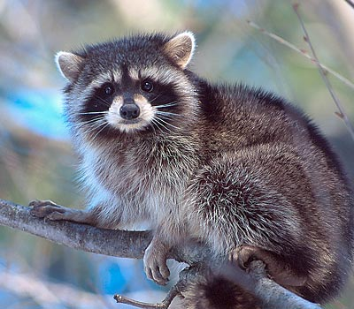
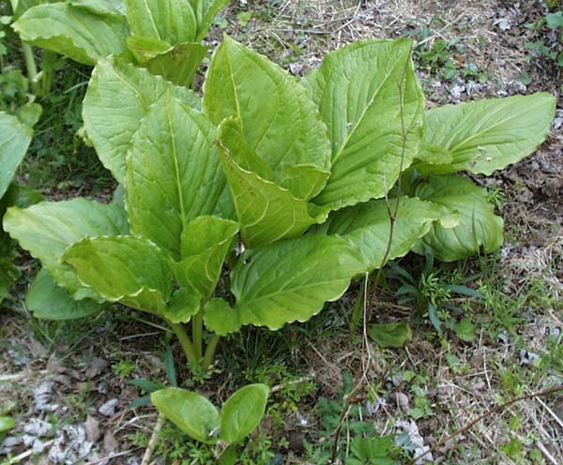
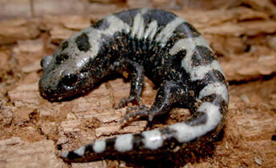
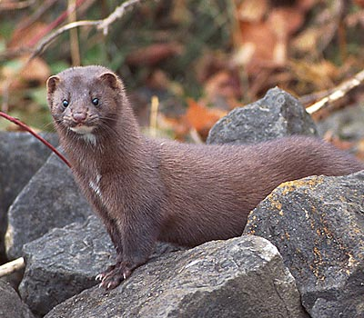
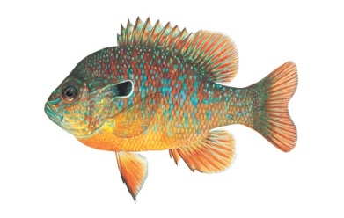
Organism Research
Where does your organism live?
What is the diet of your organism?
What interactions with other organisms does your organism need to survive?
What output does your organism produce?
What input into the system does your organism need?
What makes your organism an important part of the ecosystem?

Slide 9
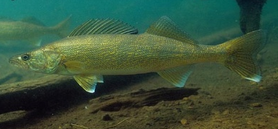
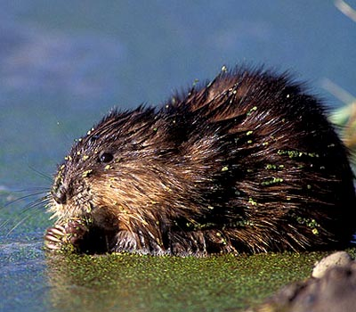
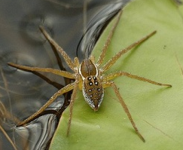
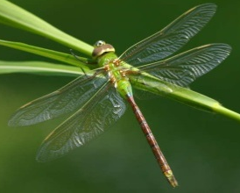
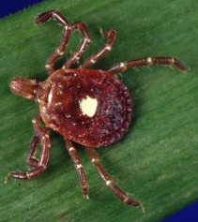
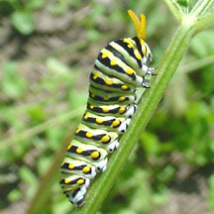
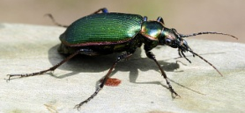
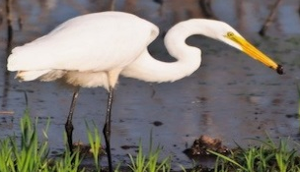
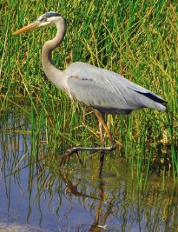
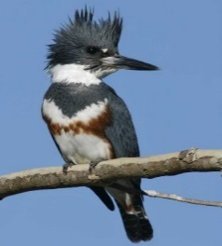
Mammals
Fish
Arachnids
Insects
Amphibians
Birds
Reptiles

Slide 10
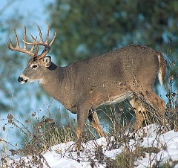
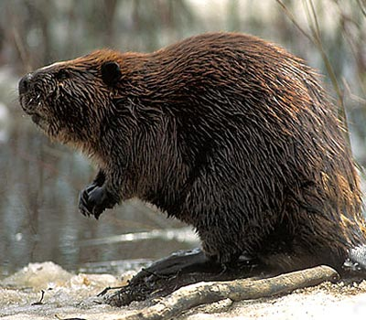
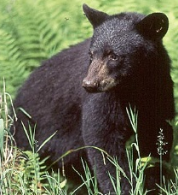
Carnivores
Herbivores
Parasite
Omnivores

Slide 11
ECOSYSTEMS
What are the boundaries of the river ecosystem?
What are some of the elements of the river ecosystem?
Would the spill be considered an input to the system? How do you know?
What are some interactions between the elements of the system?

Slide 12
To: State Highway Patrol Supervisor
From: Arkansas Public Works Central Office
An ecological awareness group calling itself Friends of Saline River System has sent us the email below. They claim that if the corrosive spill is not immediately addressed, they will alert the local and national media and start a boycott of Coleman Chemicals. They are also initiating a lawsuit against the state of Arkansas for improperly handling the spill and another lawsuit against Coleman Chemicals for transporting materials of an acidic nature on a public highway.
Please inform us of your cleanup efforts immediately.
ALERT! ALERT! ALERT! ALERT!
North Fork River is getting more and more polluted by the second… the water is becoming more dangerous for all living things. No one is taking action to halt the spread of the acid spill. Call your elected representatives. Call the highway patrol. Let them know how you feel about dangerous materials being transported on your highways. Put the pressure on and SAVE NORTH FORK RIVER!
Signed,
Friends of Saline River System

Slide 13
Problem Log Questions on Ecosystems
Are the ecology group’s concerns legitimate? Why or why not?
What information do we already know that will help us answer the ecology group’s questions?
Are there other stakeholders whose concerns should be taken into consideration? Which ones? Why?

Slide 14
Problem Log Questions on Effects of Acids on Plants and on Various Materials
What effect did acid have on the radish seeds?
How does this new information affect our problem?
Why is it important to know the effect of acid on different materials from the spill site?
Will changes to the material be instantaneous or will they occur over time? How do you know?
How does this information change the way you think about our problem?

Slide 15
Weather Report
The long-range forecast:
Tuesday-High temperature in the 60's, low in the 40's; clear skies, winds from the northwest at 10 miles an hour.
Wednesday-Starting out the same as Tuesday, with highs in the mid-60's, clouding over in the
afternoon and winds shifting to the southwest. Chance of showers 20%. Low temperatures in the mid-40's.
Thursday-Cloud cover increasing as the day progresses. Highs in the upper
60's, with winds from the southwest at 20-30 miles an hour. Chance of heavy thunderstorms in the afternoon. Chance of rain 30% in the morning and increasing to 80% in the afternoon.
Friday- Heavy thunderstorms likely, with strong winds from the southwest at 40 miles an hour. Highs in the low 70's; chance of rain 90%.
What are the implications of the weather report?
How does this relate to the solution of our problem?
What are the implications of having acid in the area for four more days?
What is the best solution to the problem?
Are there secondary effects of this solution?
How is the solution affected by the increase in wind?
What options are no longer possible? Why?

Slide 16
What is the problem? What is your solution?
What criteria will you use to judge the success of your solution?
What sacrifices did you have to make in order to come up with the best possible solution?

