Slide 1
What types of problems do transportation engineers solve and what are some factors they work to balance?
Did anyone travel through an intersection this morning on his or her way to school?
Did you feel safe going through the intersection? Why or why not?
Did you notice any technologies that helped make the intersection safe?

Slide 2
What is a model?
Why do you think you are using a model here?

Slide 3
On what side of the road must vehicles travel?
What does the solid, double line mean?
What does the dashed line mean?
What does the solid, single line across the road mean?
If you want to make a right or a left turn at the intersection, what should you do?
What does the word “efficient” mean?

Slide 6
Do you think the current intersection model will work well for pedestrians? Why or why not?
What could we change about the intersection to make it safer and more efficient for pedestrians?

Slide 7
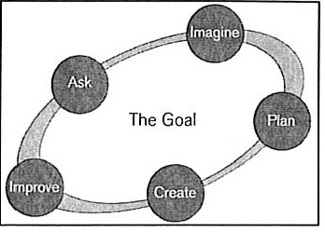
Do you think we used the Engineering Design Process in this activity? Explain.

