Slide 1
How can we use the properties of magnets to help us design a maglev transportation system?
What parts does the maglev transportation system need to have?
How did Hikaru’s Maglev Package Transportation System work?
What do you already know about magnets?
What are some properties of magnets we might need to know to design our maglev transportation systems?

Slide 2
Levitating Magnets
How could you make one magnet levitate above the other?
Place two ring magnets on the pencil and make one magnet levitate over the other.
Flip one of the magnets over. What happens? Why?
What happens when you flip both magnets over? Why?

Slide 3
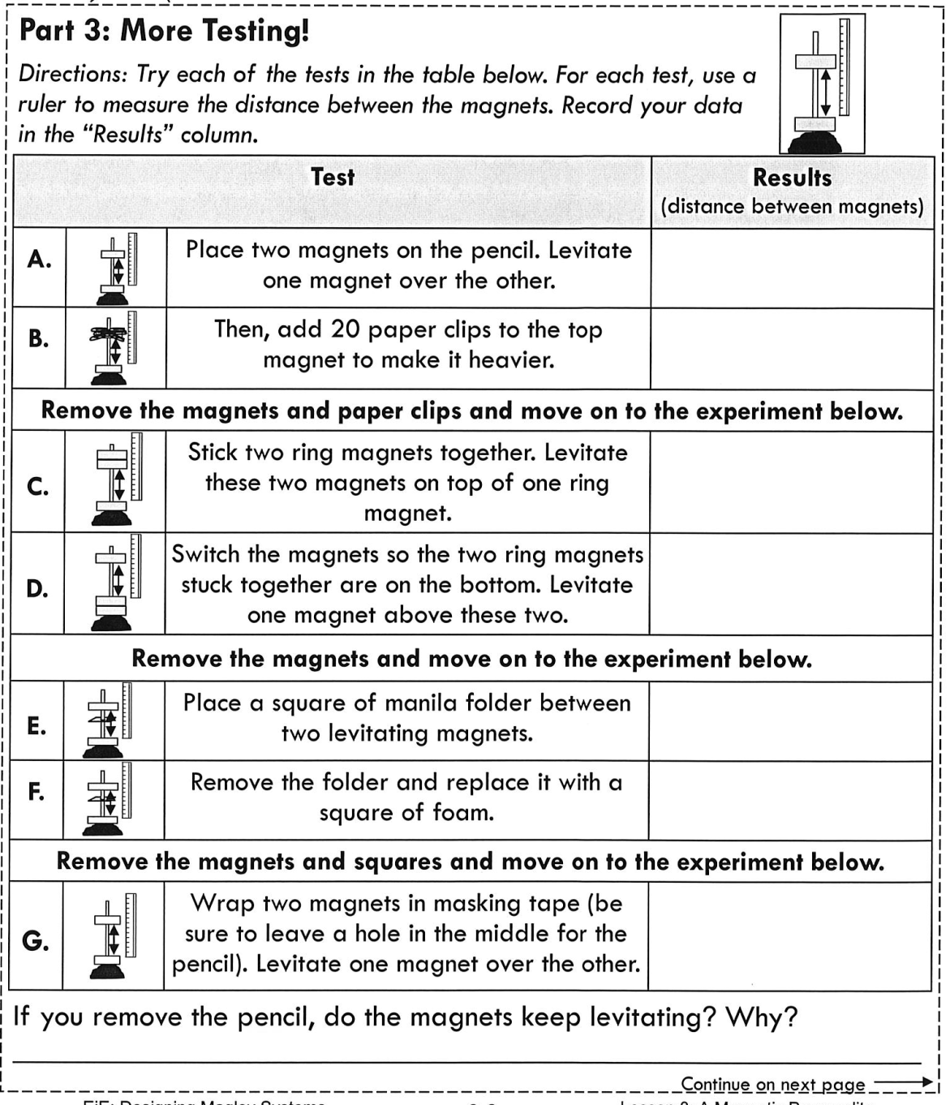
Levitating Magnets
List three properties of magnets that you observed during this investigation.
Explain how each property helped you to levitate magnets.
Complete FIND THE POLES when you are finished with this station.

Slide 4
Magnetic Sailing
In this activity the goal is to move the sailboat from one side of the basin to the other without touching it.
You can flip the ring magnets over on their posts or move individual ring magnets from their posts.
If you move a magnet from its post, you may either remove it from the board, or stack it on top of another magnet on another post.
You may NOT wave the magnets over the basin or touch the sailboat.
Once you move a magnet wait ten seconds to see what happens.
Do you have any ideas about how you could make the sailboat move?

Slide 5
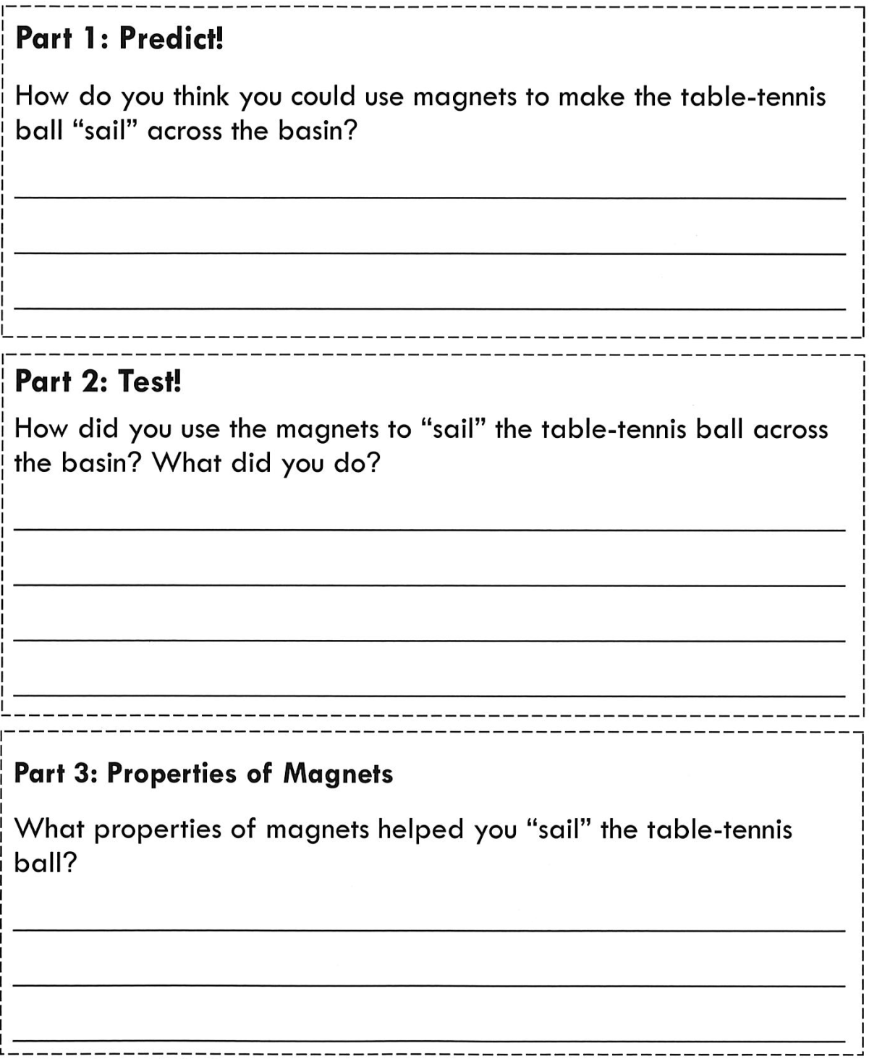
Magnetic Sailing

Slide 6
Find the Poles

Slide 7
Reflection
Why are the magnets levitating?
Why do you think adding more magnets affects how high they levitate?
What did you do to make the top magnet levitate higher?
What happened when you placed the foam or stiff paper between the magnets or wrapped the magnets in tape? Why?
Why did the sailboat move? How do you know?
How do you know where the poles of the unmarked magnets are?
What properties of magnets have we explored?
What else might we want to know about our magnets before we design our maglev transportation systems?

Slide 8
Strength of Magnets
Why do you think magnet strength is important to our maglev system design?
How could we figure out how strong a magnet is?

Slide 9
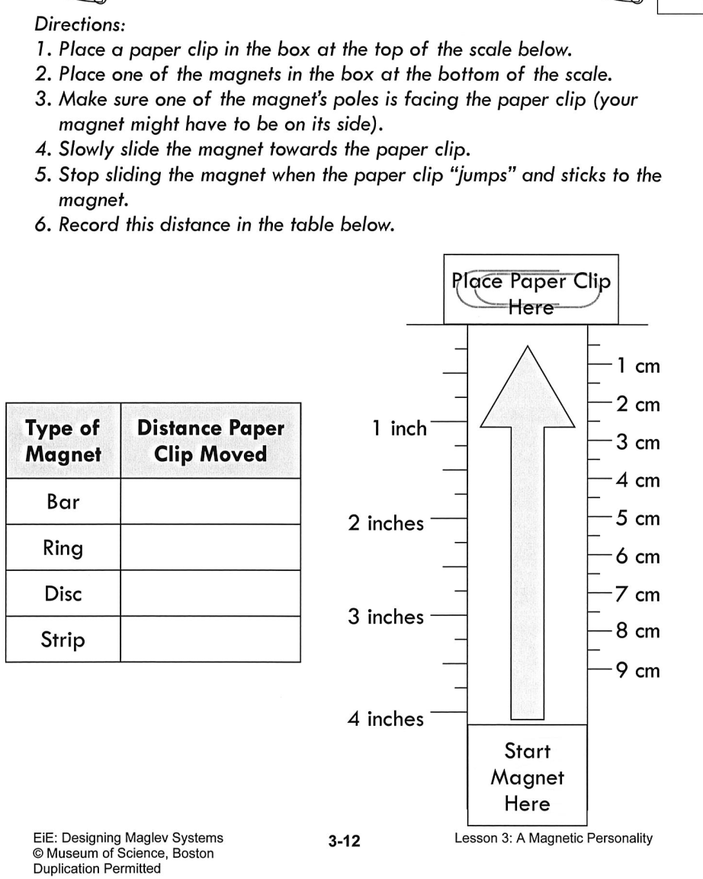
Strength of Magnets
Which magnet had the strongest magnetic field? Which had the weakest? How do you know?
What do you predict would happen if the paper clip was heavier? Lighter?
What do you predict would happen if the paperclip was made of a different material?
How will this activity help with the design of your maglev transportation system?
Do you think using more magnets in your design will always make your design better? Explain.
Do you think it matters how close together or far apart you place your magnets on the maglev track? Explain.

