Slide 1
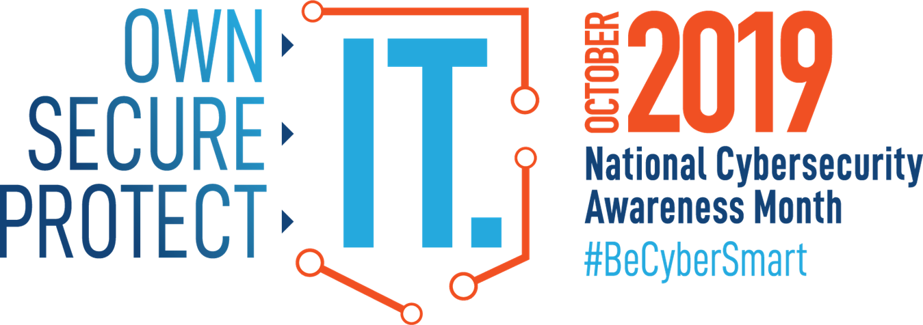
Veysel ERDAG, PhD
Chief Information Security Officer
CISM, CISA, CISSP, CCIE-Security
overdag@ualr.edu

Slide 2
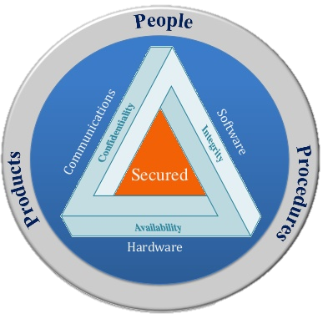
INFOSEC Components

Slide 3
WHY?
Average cost of a data breach:
  4 Million
Average cost of a breach data:
  $221/record
Cost of a data breach for Higher Education:
  $246/record
UALR has approximately 500.000 records
  $123 Million
Root cause of data breaches:
  48%: Malicious or criminal attacks
  27%: System glitches
25%: Human errors

Slide 4
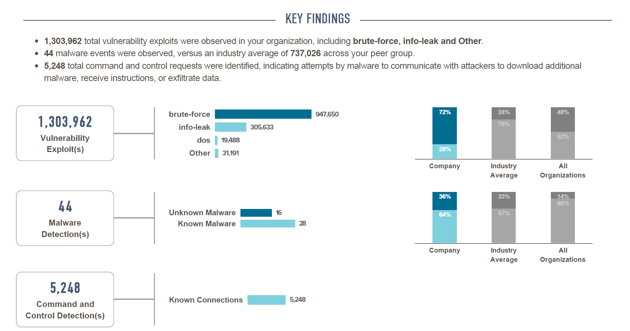
SNAPSHOT

Slide 5
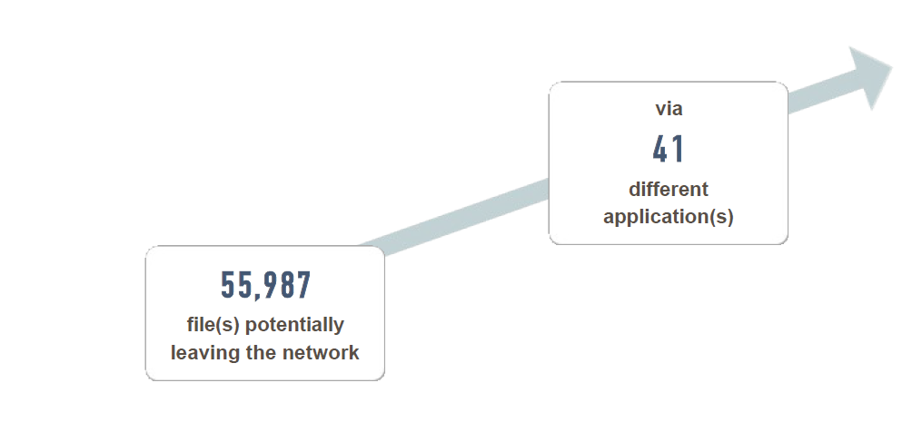

Slide 6
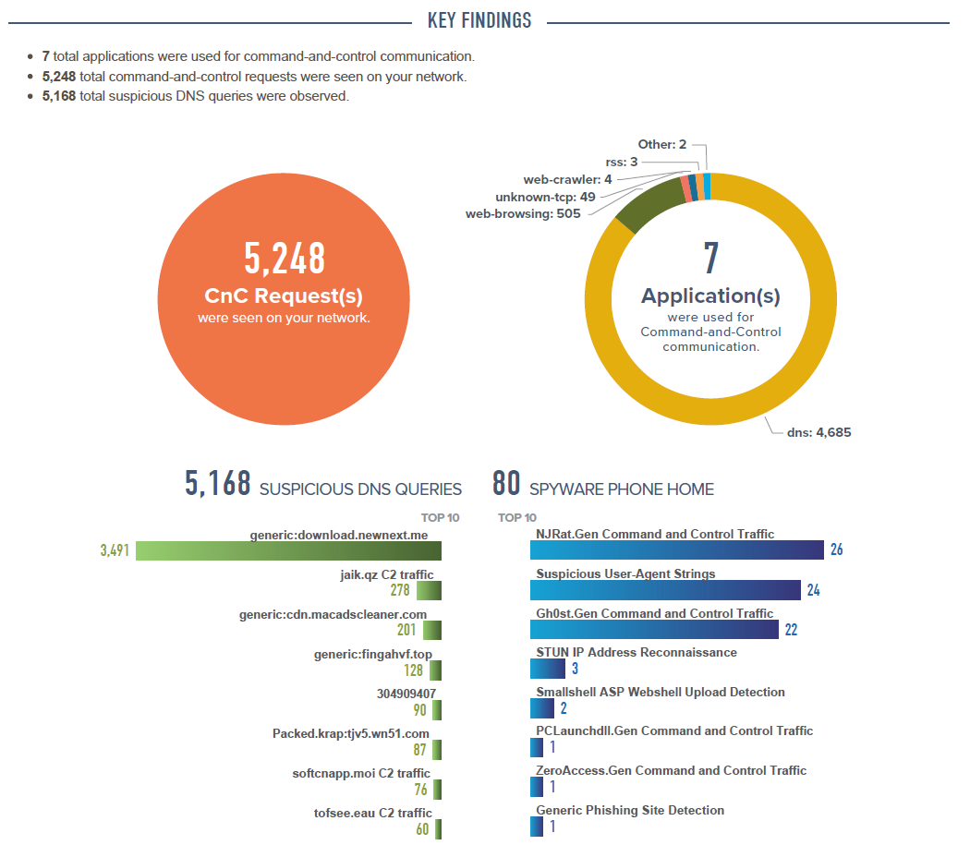

Slide 7
Security Systems in UA Little Rock
Comprehensive, security in depth design
New Active Directory
New End-Point Security Solution
  Symantec
Information security training.

Slide 8
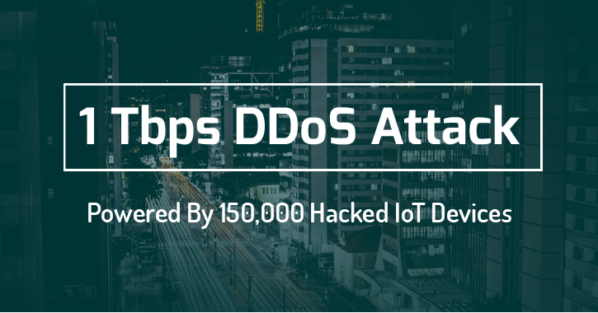
Data Breaches: Huge Numbers
Denial of Service Attacks: Un-stoppable

Slide 9
How to Detect Phishing Attacks-1?

Slide 10
How to Detect Phishing Attacks-2?

Slide 11
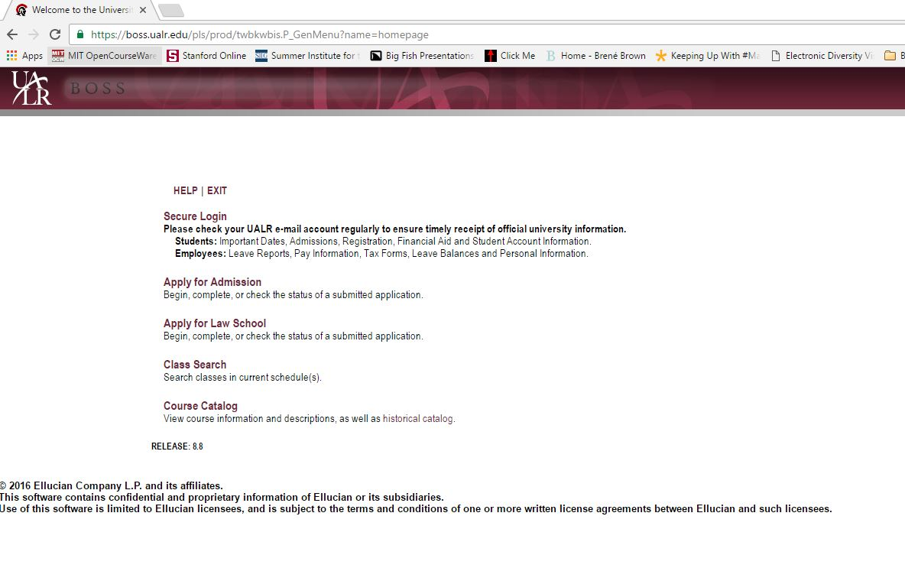
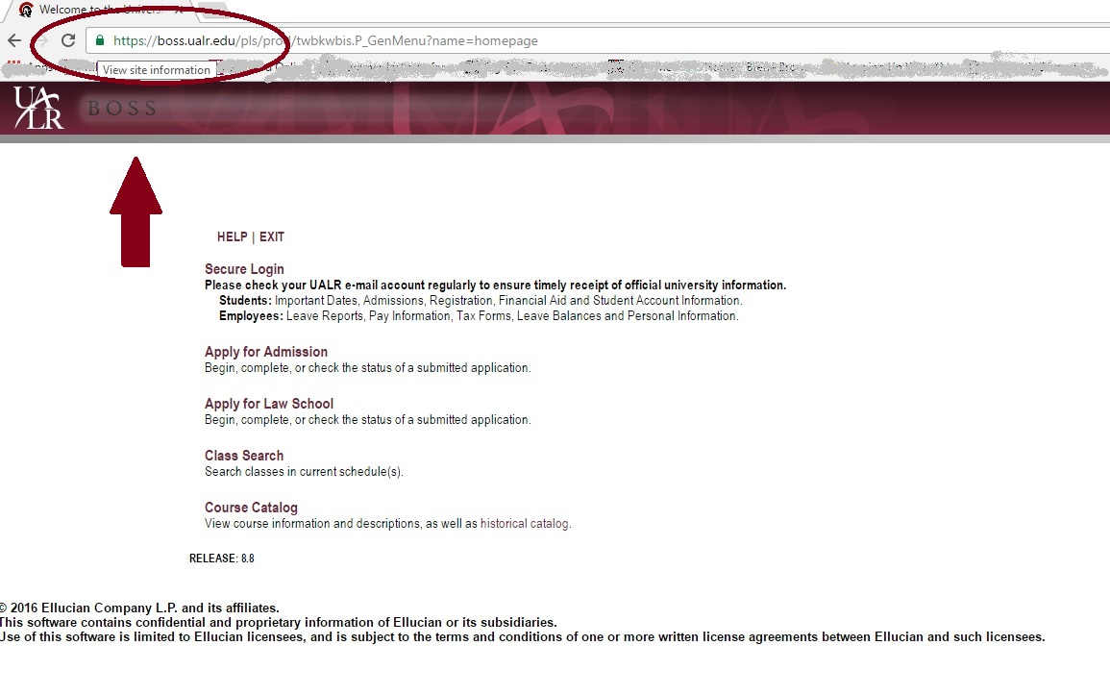
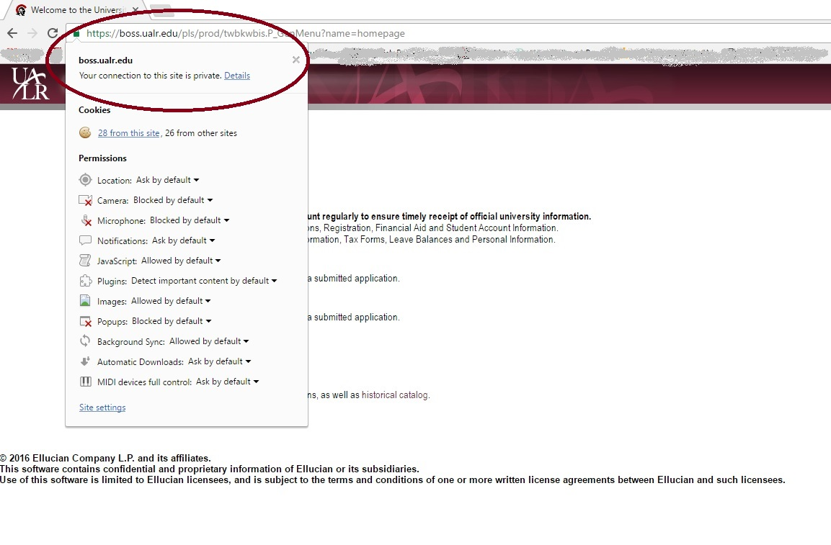
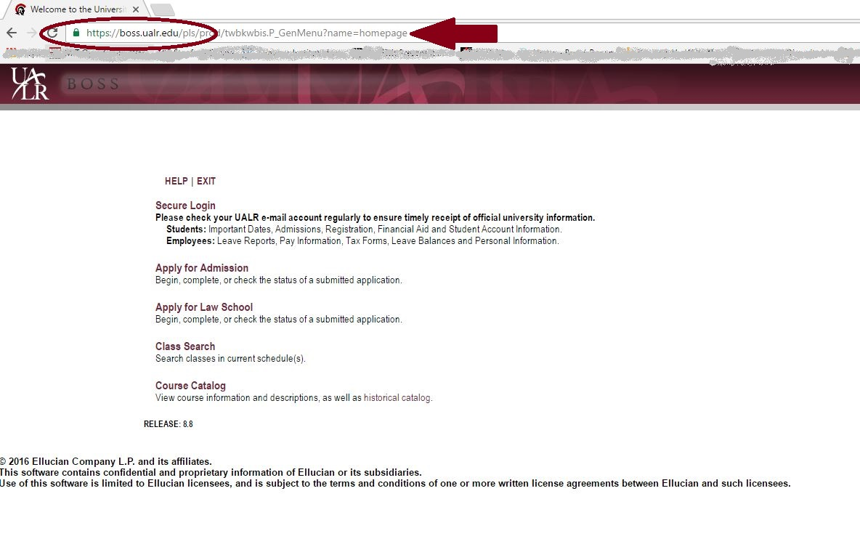
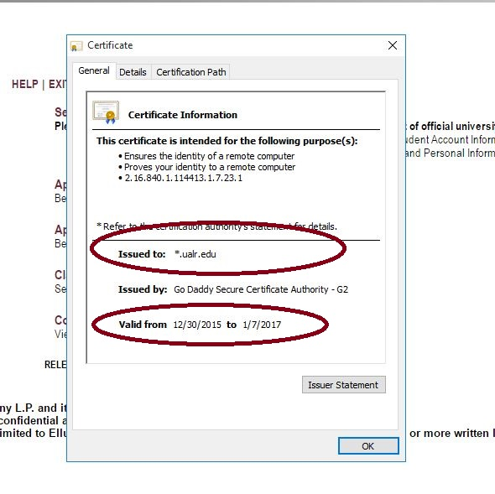
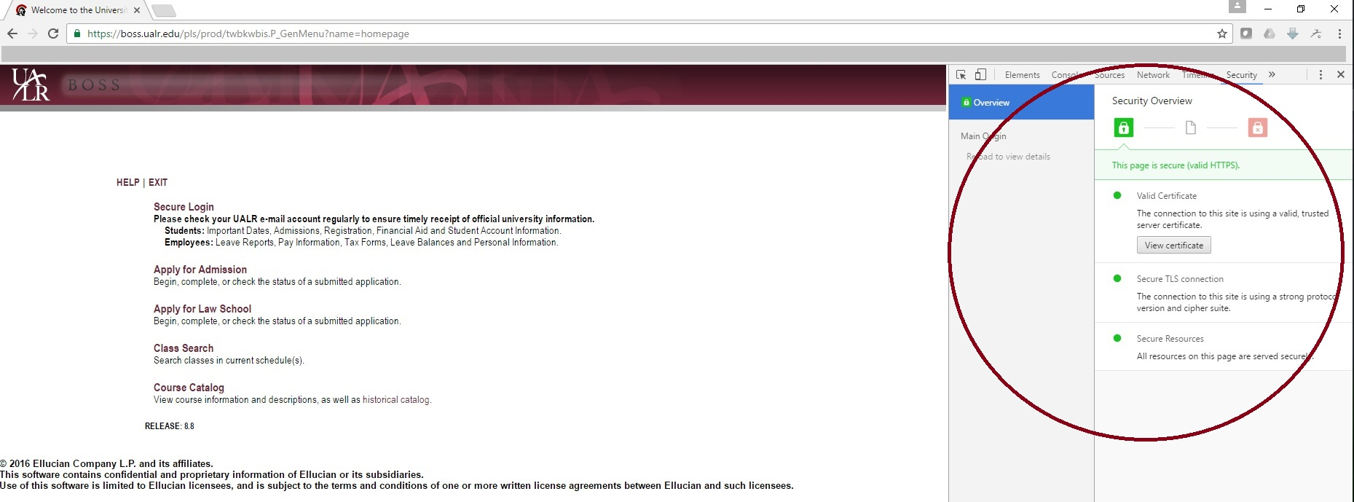
Protect Your Identity and Financial Information – Secure Web Connection

Slide 12
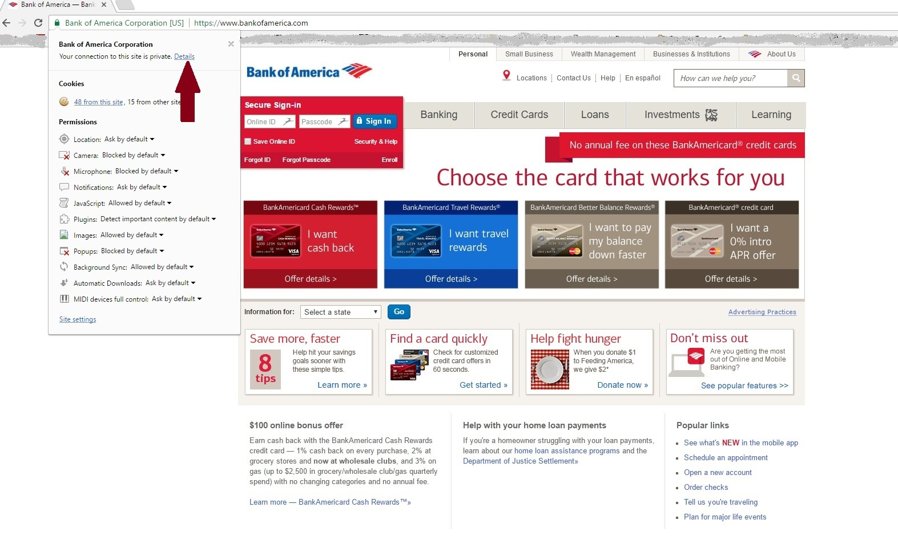
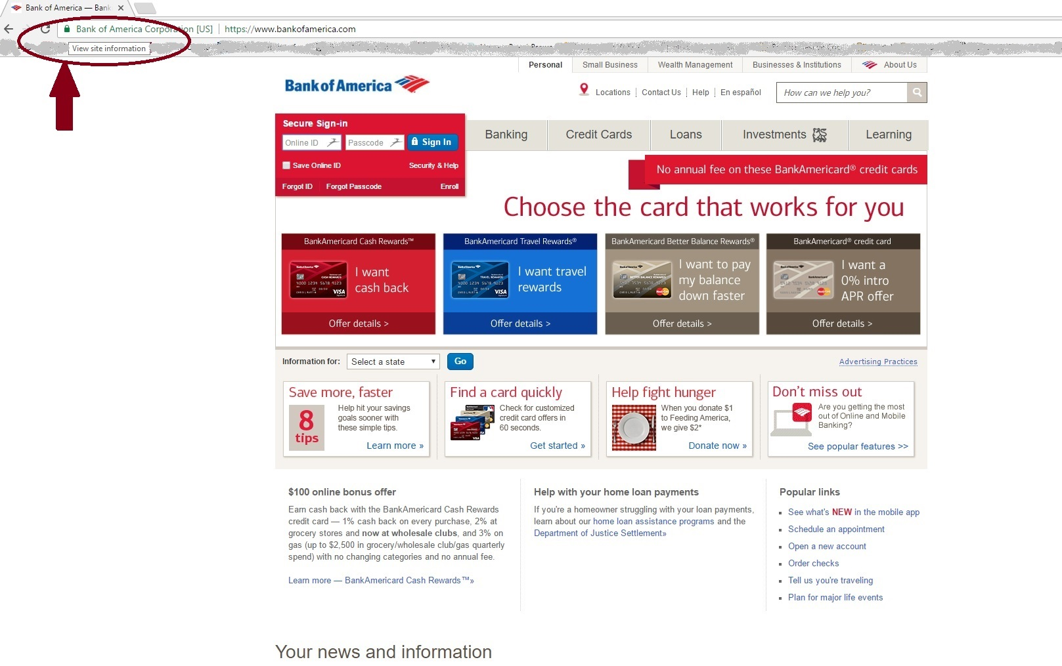
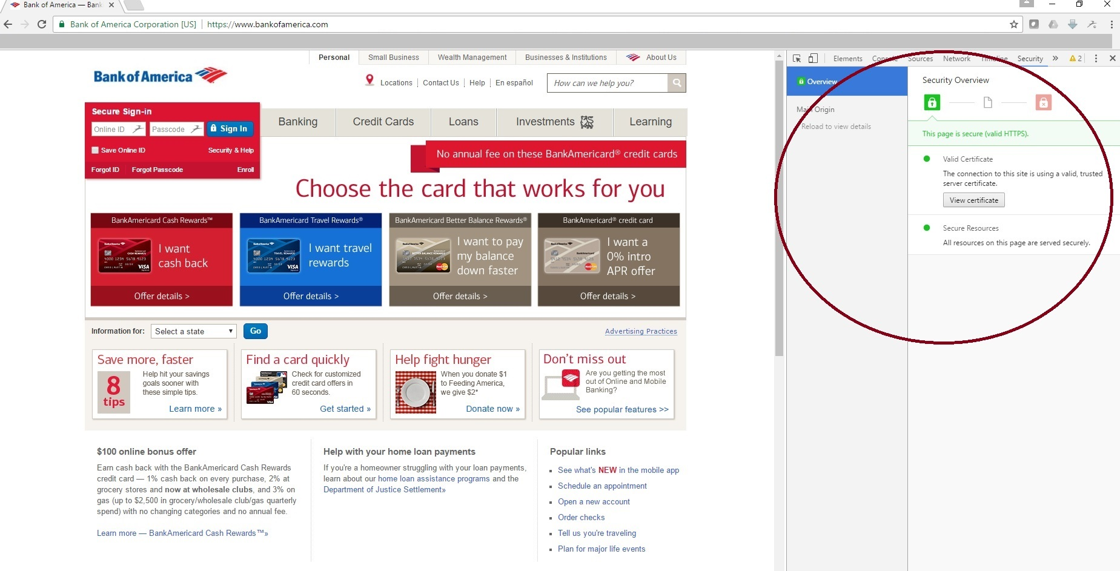
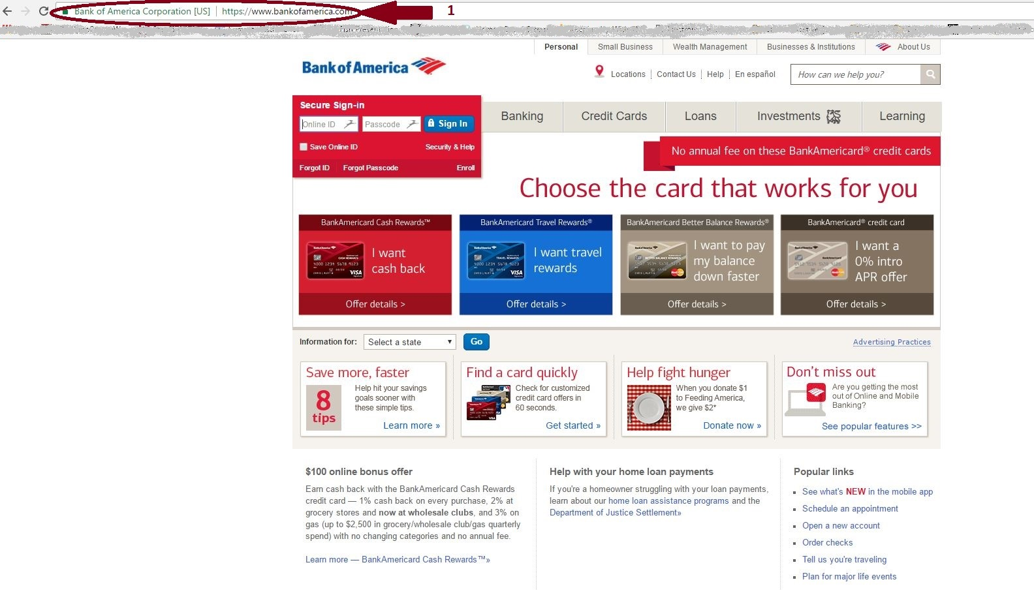
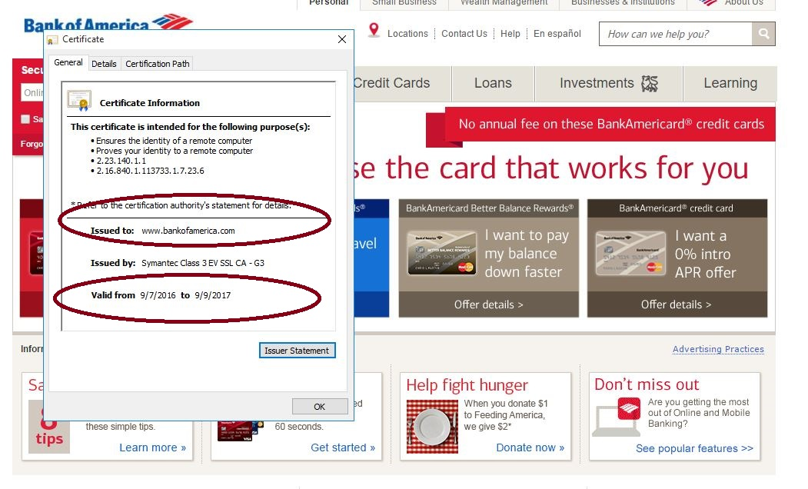
Protect Your Identity and Financial Information – Secure Web Connection – 2

Slide 13
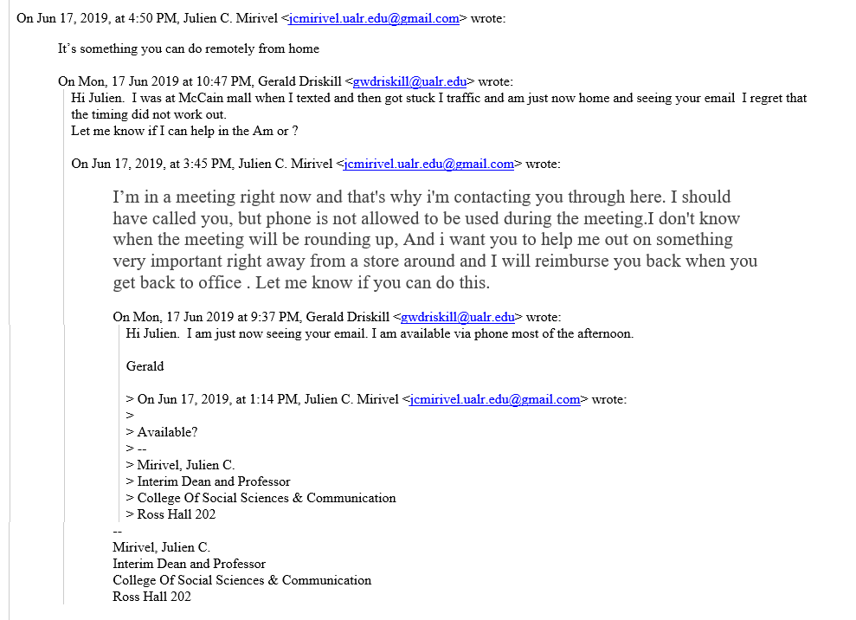
Gift Card Attacks

Slide 14
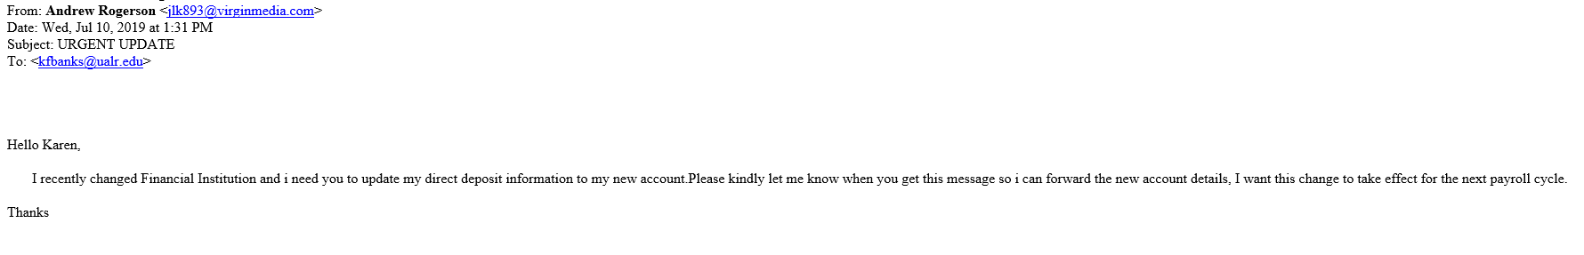
Payroll Attacks

Slide 15
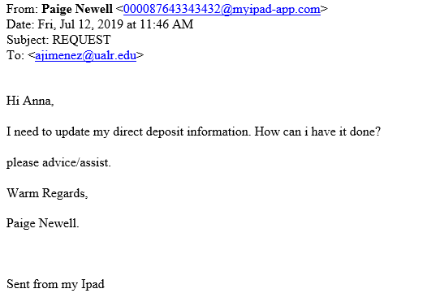

Slide 16
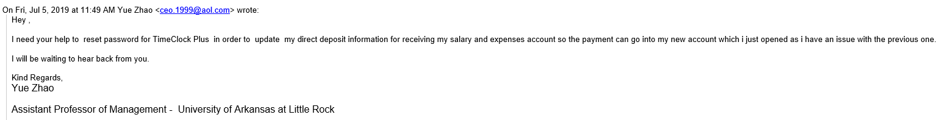
Password Reset Request

Slide 17
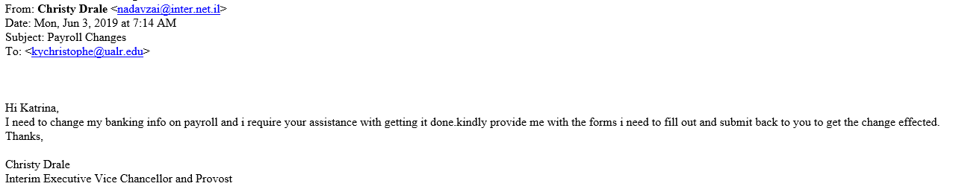
Payroll Change Request - Chancellor

Slide 18
What should we do?
Protect yourself first:
  Set a strong password
    Should be at least eight characters in length
    Should contain at least one lowercase character
    Should contain at least one number
    Should contain at least one special character
    Should contain at least one uppercase character
    Should not contain your first name, last name, or username
  Use different passwords for every different application or website.
  If you have difficulties to remember your passwords, please use a password-vault application.
  Social Networks like Twitter, Linkedin and Facebook are providing two factor authentication.
    Activate two factor authentication if the service is provided by the website.

Slide 19
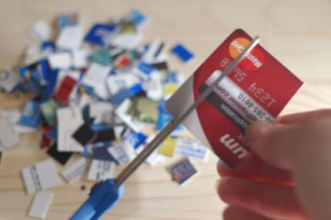
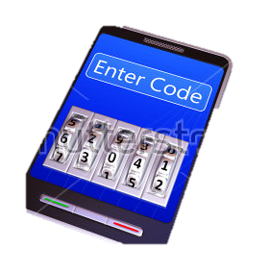
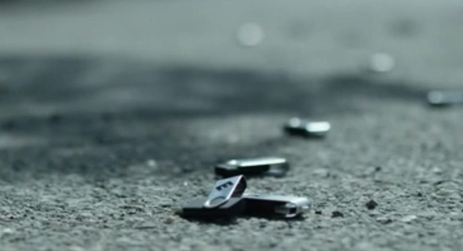
Protection
Control your visibility
Be careful about your posts
Secure your mobile device
Be careful about USB storage devices
Use VPN
Dispose your information properly
Update your systems
Backup regularly

Slide 20
Connected Devices – IoT (Internet of Things)
Connected everything
  Household devices
  Game consoles
  Your personal tracking devices
  …
Attackers can collect personal information:
  Your location
  Your health information
  Your behavioral habits, daily routines
Follow the guidelines in UALR IT Services Security website.

Slide 21
Last Words and Reminders
Keep your passwords secret.
  Do not share your password with anybody
IT Services never ask your password
  On the phone or via e-mail
Change your passwords as frequent as possible.
Use security solutions provided by UALR
Be the part of the community and help your community to protect and to be protected
If you see any suspicious activity, please call IT Services Assistance Center
  501 – 916 3011
  Itservices-help@ualr.edu

Slide 22
T H A N K Y O U
overdag@ualr.edu

