Slide 1
Arkansas’s Health Insurance Marketplace
*****
University of Arkansas at Little Rock Law Review
Choices and Consequences: Health Policy and the ACA
Little Rock, February 28, 2014
*****
Cynthia Crone, Deputy Commissioner
Arkansas Insurance Department
Arkansas Health Connector Division

Slide 2
Marketplace Advances ACA Goals
Expand access to affordable, quality care
Improve quality and efficiency
Constrain rising costs

Slide 3
Marketplace Advances Arkansas Goals
Cover more than a half million uninsured Arkansans with quality, affordable insurance.
Attract new issuers and competition to AR.
Support providers to help keep healthcare local.
Improve economic health of Arkansas.
Support overall health system improvement efforts aimed at quality and payment transformations.

Slide 4
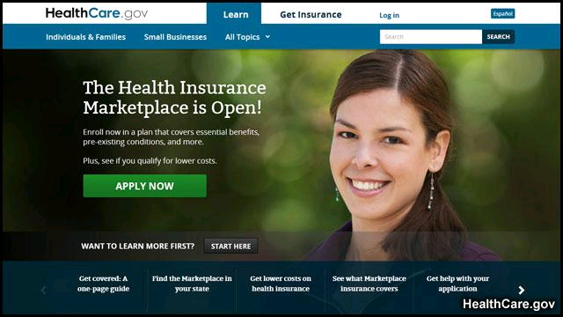
Following three years of planning….
The Health Insurance Marketplace in Arkansas is open for business!

Slide 5
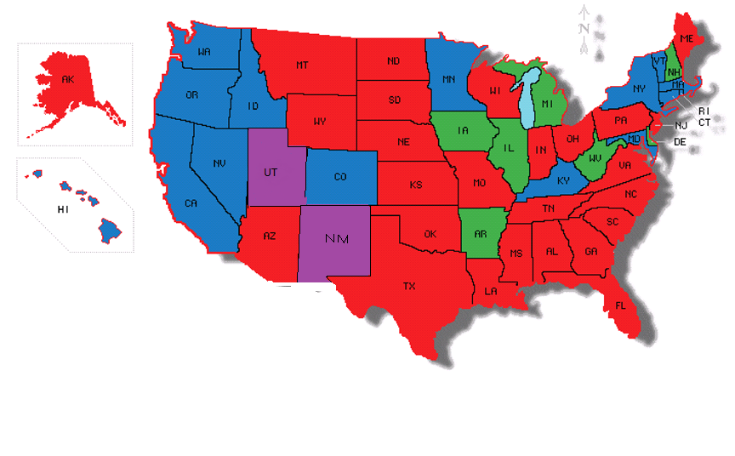
Status of Marketplaces
State-Based Marketplace
State-Based Marketplace (SHOP only)
Partnership Marketplace
Federal Marketplace

Slide 6
How did we get to where we are? There have been many steps along the way

Slide 7
March 2010
Affordable Care Act signed into law by President Obama.
September 2010
Arkansas Insurance Department awarded Federal Exchange Planning Grant.

Slide 8
April 2011
Arkansas legislature declines to enact bill to establish State-Based Marketplace through AID.
December 2011
Governor Beebe directs AID to pursue State Partnership Marketplace model.

Slide 9
June 2012 U.S. Supreme Court upholds ACA individual mandate and rules Medicaid Expansion is a State choice.
November 2012
President Obama re-elected. Arkansas elects Republican Legislature --House and Senate.

Slide 10
December 2012
Governor Beebe declares intent for Arkansas to establish a State Partnership Marketplace (SPM) for 2014 and AID submits SPM Blueprint.
HHS Secretary Sebelius grants conditional approval for Arkansas’s SPM.
April 2013
Arkansas Legislature approves linking the Marketplace to the Private Option and to allow for a State-Based Marketplace (SBM) by 2016.

Slide 11
October 1, 2013
Open enrollment for Marketplace plans begins and runs through March 31, 2014.
January 1, 2014
Coverage in Marketplace plans begins.

Slide 12
Diverse Partners Working Together
Government Policy Makers
State <–> Federal (Appointed and Elected)
State <–> State (Appointed and Elected)
Policy Makers <–> Non-Government Constituents
Consumers and Consumer Advocates
Health Care Providers
Health Care Insurers
Businesses

Slide 13
Inclusive Stakeholder Engagement
Consumer Assistance and Plan Management Advisory Committees
Four Level One Establishment Grants to Date
Arkansas Health Connector Staff & Consultants
Research / Alternatives Analysis
Consumer Assistance Advisory Committee
Plan Management Advisory Committee
Develop Recommendations with Alternatives
Steering Committee
Final Recommendation to Commissioner

Slide 14
Examples of Arkansas-Specific Plan Management Decisions
QHP approval by Certification vs. Competitive Bidding
Maximum 20% Upcharge for Tobacco Use Allowed
Medicaid Premium Assistance (Private Option) will be offered through High-Level Silver Plan

Slide 15
Examples of Arkansas – Specific Consumer Assistance Decisions
Standards for In-Person Assister (IPA) entities and Guides/other assister licensure.
Standards for Assister Training
Respond to ongoing feedback and improvement recommendations for outreach/education efforts
Arkansas Health Connector Resource Center

Slide 16
AR State Partnership Marketplace Health Insurance Medical Issuers - 2014
Arkansas Blue Cross and Blue Shield
Blue Cross and Blue Shield Multi-State
QualChoice of Arkansas
Celtic, doing business as Arkansas Health and Wellness Solutions (Ambetter)

Slide 17
Qualified Health Plans in Arkansas Marketplace - 2014
Metal Level | Actuarial Value | Number of Plans*
Gold | 80 percent | 23
Silver | 70 percent | 16
Bronze | 60 percent | 24
Additionally, 8 catastrophic plans are offered

Slide 18
Stand-Alone Dental Issuers Offer 24 Plans
Arkansas Blue Cross and Blue Shield
Best Life and Health
Delta Dental of Arkansas
Dentegra Insurance Company

Slide 19
Premium Limits Based on Income
INCOME | PREMIUM LIMIT
0 - 138% FPL (Medicaid Expansion) | 0
100 - 138% FPL (non-Medicaid eligible) | 2% of income
139 – 149% FPL | 3 – 4% of income
150 – 199% FPL | 4 – 6.3% of income
200 – 249% FPL | 6.3 – 8.05% of income
250 – 299% FPL | 8.05 – 9.5% of income
300 – <400% FPL | 9.5% of income

Slide 20
2013 Federal Poverty Guidelines
FAMILY SIZE | 100% | 138% | 200% | 400%
1 | $11,490 | $15,856 | $22,980 | $45,960
2 | $15,510 | $21,404 | $31,020 | $62,040
3 | $19,530 | $26,951 | $39,060 | $78,120
4 | $23,550 | $32,499 | $47,100 | $94,200
5 | $27,570 | $38,047 | $55,140 | $110,280
6 | $31,590 | $43,594 | $63,180 | $126,360
7 | $36,610 | $49,142 | $71,220 | $142,440
8 | $39,630 | $54,689 | $79,260 | $158,520
For each Additional person, add | $4,020 | $5,347 | $8,040 | $16,080

Slide 21
Tax Credits at Work
With an average base individual monthly premium of $259 in Arkansas for second-lowest price Silver plan, these examples show what a 30-year-old non-smoker will pay in monthly premium:
Annual income | Tax credit | Out-of-pocket premium cost
$17,235 | $202 | $57
$22,980 | $139 | $120
$28,725 | $67 | $192

Slide 22
What about family costs?

Slide 23
With an average base monthly premium of $874 for a family of four (two adults age 40 with two children) in a second-lowest cost silver plan, these examples show monthly costs:
Annual income | Tax Credit | Out-of-pocket premium cost
$35,325 | $756 | $117
$47,100 | $627 | $247
$58,875 | $479 | $395

Slide 24
Premiums Vary by Age
Age | Monthly average premium without tax credits
0-20 | $153
30 | $284
40 | $320
50 | $448
60 | $680

Slide 25
Seven rating areas in Arkansas

Slide 26
Issuers/Plans per Service/Rating Area
 | Central - 1 | Northeast - 2 | Northwest - 3 | South Central - 4
Medical | 4/41 | 3/17 | 4/41 | 3/17
Dental | 4/12 | 3/10 | 3/10 | 4/12
 | Southeast - 5 | Southwest - 6 | West Central - 7
Medical | 2/11 | 2/11 | 4/35
Dental | 3/10 | 3/10 | 4/12
Rating areas are identified by their geographic area and their assigned number. The number of low dental plans is the same as the number of high dental plans.

Slide 27
Regional variances Premiums without tax credits
 | Central | North East | North West | South Central | South East | South West | West Central
Adult (age 40) | $328 | 302 | 343 | 290 | 290 | 292 | 327
2 adults, 2 children | 971 | 892 | 1,013 | 856 | 860 | 869 | 970
Child (age 0-20) | 158 | 144 | 164 | 138 | 141 | 142 | 158
Adult (age 64) | 770 | 709 | 804 | 681 | 680 | 686 | 767

Slide 28
What is covered?

Slide 29
Essential Health Benefits
Outpatient Services
Hospitalization
Emergency Services
Maternity and Newborn Care
Mental Health and Substance Use Disorder Treatment
Prescription Drugs
Rehabilitative and Habilitative Services/Devices
Laboratory Services
Preventive, Wellness, and Chronic Disease Management
Pediatric Services, Including Oral and Vision Care

Slide 30
Enrollment Options – Individual Market
How?
Who can help?
Internet
Phone
In-Person
Mail
Agents and Brokers
Guides
Navigators
Certified Application Counselors

Slide 31
Who can help? (as of February 20, 2014)

Slide 32
What about business coverage?
The Small Business Health Options Program (SHOP) is part of the Marketplace:
- For employers with 50 or fewer employees
- Only way for small employers to get tax credits
- Employer shared responsibility is not required for employers with fewer than 50 employees.
One SHOP Issuer in 2014 (BCBS) – three plans.

Slide 33
Outreach and Education
Broad multi-media “Get Informed” campaign across Arkansas July 1 – September 30, 2013

Slide 34
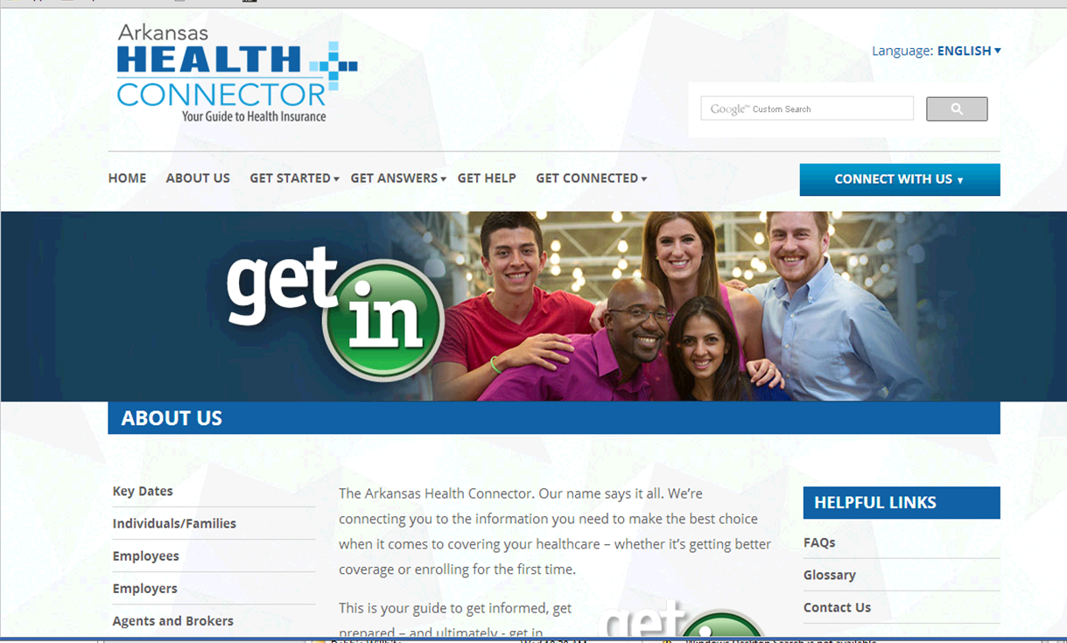
http://www.arhealthconnector.org

Slide 35
Outreach and Education
Speakers’ Bureaus/Marketplace Assisters
Funding for continuing outreach and education contract (Get Enrolled Phase) after Sept. 30, 2013 denied by Legislature.
ARHealthConnector.org website re-directed to AID-AHC web page.
Enrollment events.

Slide 36
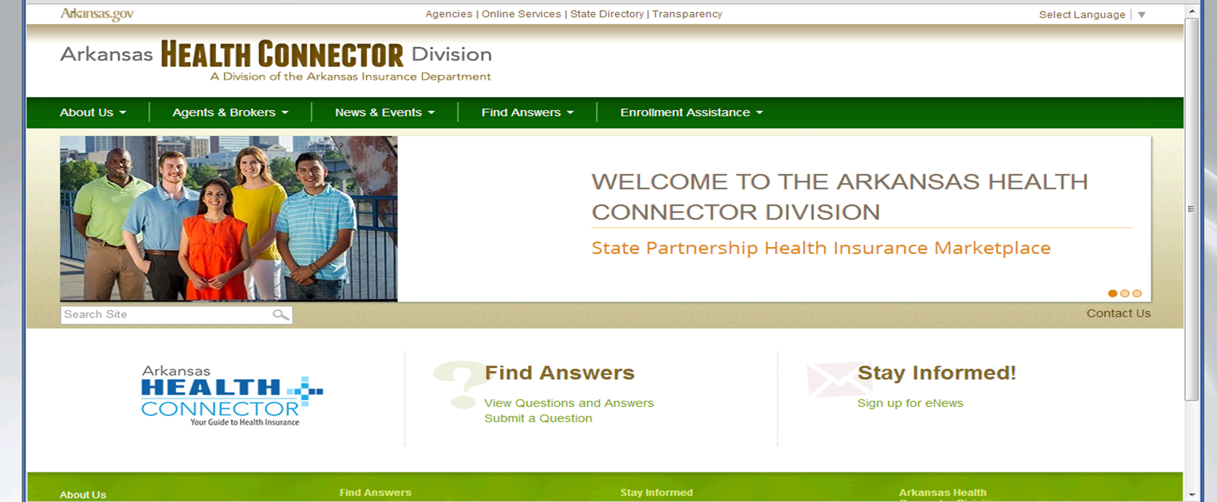
http://ahc.arkansas.gov/

Slide 37
Steady progress for Arkansans with incomes >138% FPL (Open Enrollment until March 31, 2014)

Slide 38
Preparing for 2015 Plan Year
Certification Standards
Assister Continuing Education and Re-licensure
Continued cooperation with SBM Board on transition information/issues

Slide 39
New Challenges
Compromise on Insurance Department appropriation bill to:
Eliminate outreach and promotional programs by the AID to educate consumers about their options for coverage.
Eliminate the In-Person Assister program

Slide 40
Why compromise?
A way to draw votes for the Private Option.
The possibility of more than 100,000 low income Arkansans losing their new health care coverage.
Private Option helps improve the “risk pool” for the Marketplace as a whole, keeping premiums down.

Slide 41
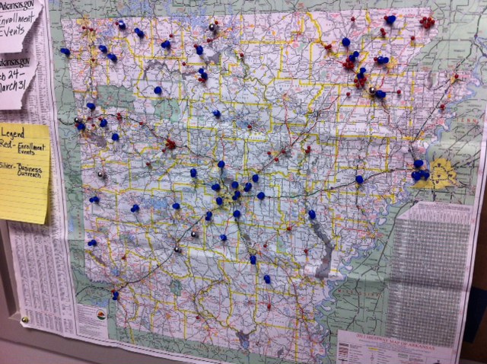
Meanwhile …
We are doing everything we can to get the word out at enrollment events throughout Arkansas

Slide 42
Contact
Cynthia.Crone@arkansas.gov
501-683-3634
www.ARHealthConnector.org
855-283-3483
www.healthcare.gov
800-318- 2596

