Slide 1


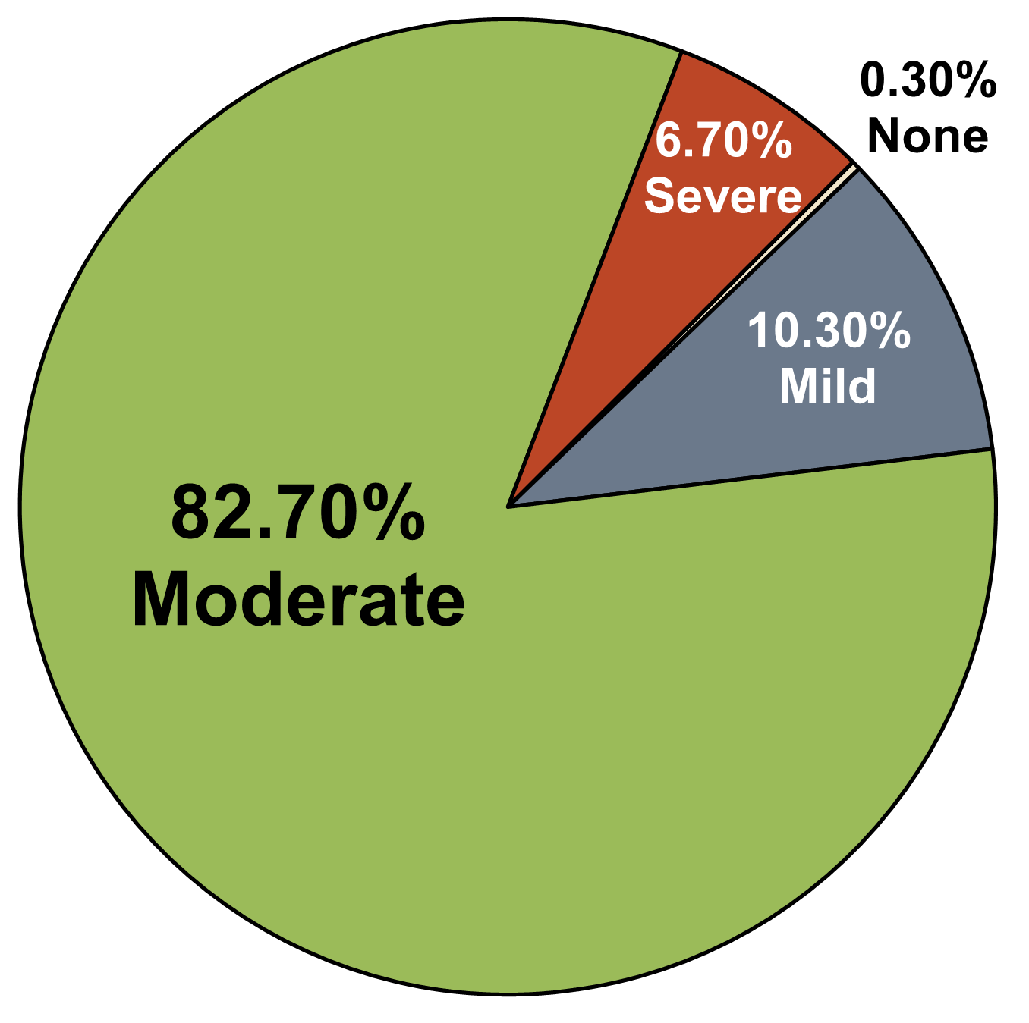
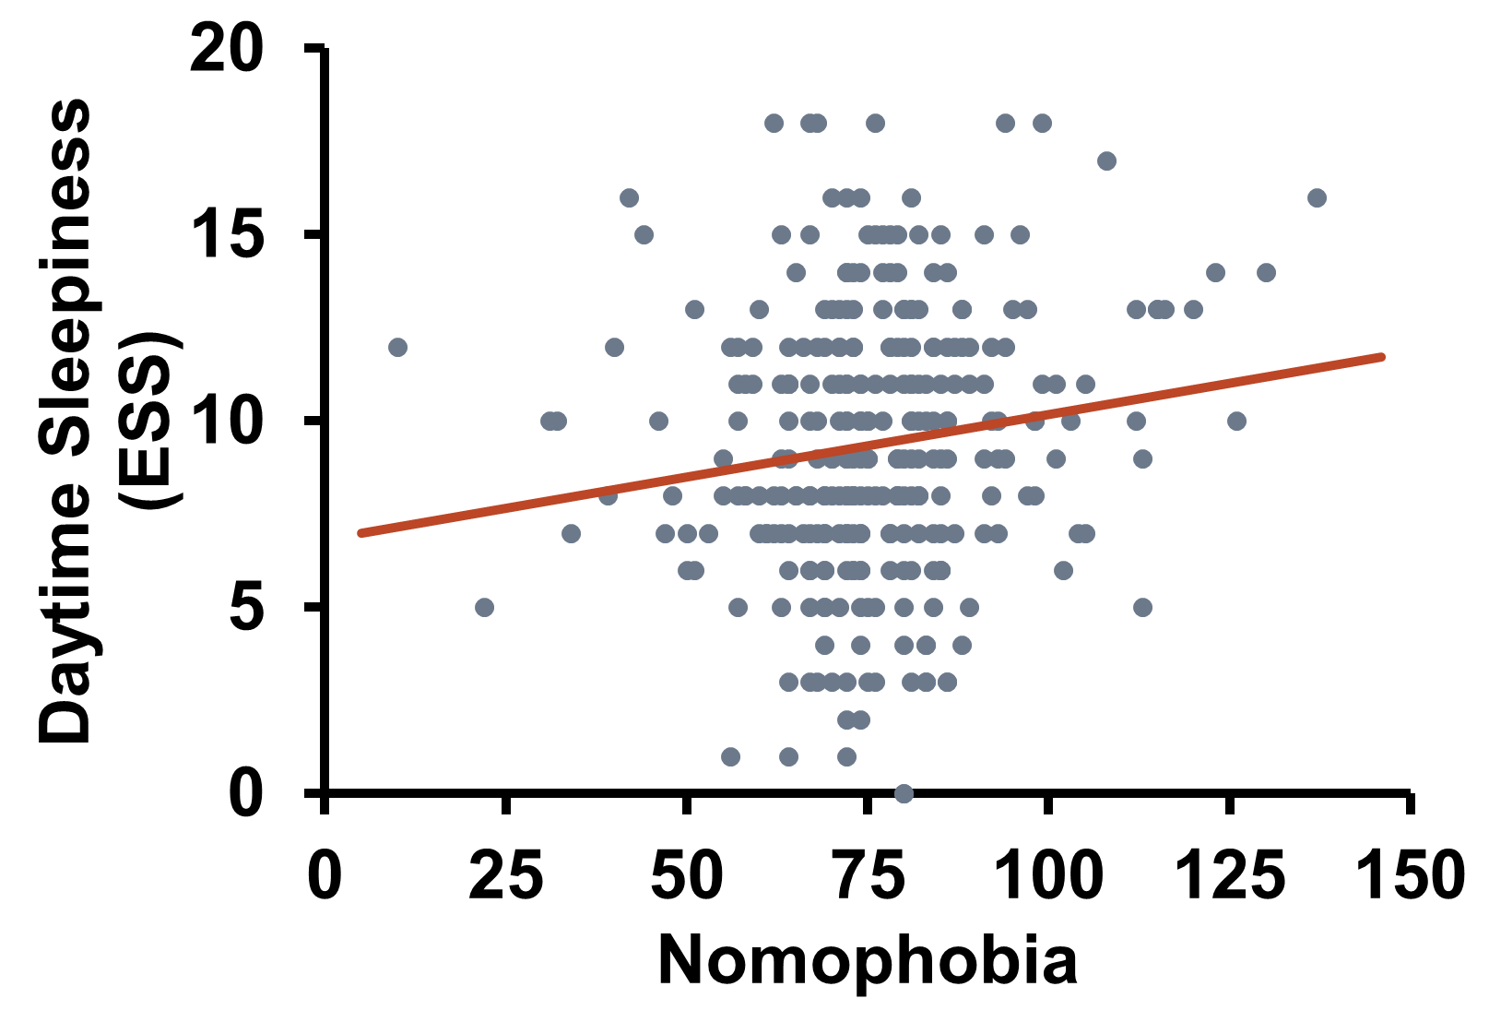
Sleep, Sleepiness, and Sleep Hygiene related to Nomophobia (No Mobile Phone Phobia)
Peszka, J. ¹, Michelle, S. ², Collins, B.T. ², Abu-Halimeh, N. ², Quattom, M. ², Henderson, M. ², Sanders, M. ², Critton, J. ²,
Moore, B. ², & Mastin, D.F. ² at Hendrix College¹ and University of Arkansas at Little Rock²
Introduction
Moderate to Severe Nomophobia is common
in this college population.
⇧ Nomophobia is related to  Maladaptive Sleep Hygiene behaviors including Sleep Time Technology Use.
Nomophobia
Nomophobia, or no mobile phone phobia, may be considered a 21st century disorder resulting from some degree of dependence on relatively novel technologies [1]. As of January 2014, 90% of the American adult population own a cell phone and 58% of American adults own a smartphone [2]. It has been shown that smartphones may lead to compulsive checking habits, compulsive usage and increased distress, and potentially addictive behavior [3]. A 2008
study found 53% of mobile phone users suffered from nomophobia. In 2012, an estimated 77% of 18-24-year-olds could be identified as experiencing nomophobia [3].
Nomophobia is prevalent in this population. A large segment (89.4%) of this college-age population were classified as experiencing either moderate or severe nomophobia. Only 1 participant reported no nomophobia at all.
Nomophobia and Sleep Disruption
Severity of nomophobia was also positively correlated with severity of maladaptive sleep hygiene behaviors. Not surprisingly, more nomophobia was related to greater active use of one’s cell phone during sleep time (r(298) = .249, p < .05). Relatedly, because nomophobia is one subset of anxiety, it was not surprising that individuals with greater nomophobia were also more likely to engage in anxiety related cognitive rumination (think, plan, or worry) while in bed (r(295) = .182, p < .05). Other maladaptive sleep hygiene behaviors related to greater nomophobia included the following: long daytime naps (r(298) = .101, p < .05), inconsistent bedtimes (r(294) = .144, p < .05), inconsistent wake times (r(291) = .103, p < .05), using bed for non-sleep purposes (r(298) = .180, p < .05), and, somewhat unexpectedly, the likelihood of sleeping in an uncomfortable bed (r(297) = .097, p < .05).
Previously, active phone use at bedtime has been implicated in disrupted sleep and related complaints [4]. To improve sleep, a recommendation following such findings is limiting phone use before and during bedtime. However, for those with the characteristic of nomophobia, this recommendation could exacerbate anxiety at and around bedtime and disrupt, rather than improve, sleep.
⇧ Nomophobia is related to
⇧ Sleepiness.
Greater severity of nomophobia was correlated with greater sleepiness measured by both the ESS (r (293) = .150, p <.05) and the single-item AFISH daytime sleepiness item (r (297) = .097, p <.05). Greater severity of nomophobia was also related to increased reports of avolition (r (297) = .100,
p < .05), a commonly reported symptom of insufficient sleep.
Other symptoms associated with insufficient sleep (preoccupation with sleep, mood disturbance, and impaired cognition) were not significantly related to nomophobia severity (p > .05).
r² = .0225
The Current Study
Because of the prevalence of nomophobia and its possible interaction with sleep, we explored the existence of nomophobia in a college-age population and its relationship to sleep, sleepiness, and sleep hygiene behaviors.
Research Question:
Is nomophobia related to sleep hygiene behaviors and sleepiness?
Method
Participants and Procedure
Participants: Undergraduate students (N=327; M_{age}=19.7 years, SD=3.78) recruited from introductory psychology courses and campus newsletters were given extra credit or a chance to win $25 gift cards for participation.
Questionnaires
The relationship between Nomophobia and Sleepiness is mediated by Active Sleep Time Technology Use
Subjective Sleepiness: Overall level of subjective daytime sleepiness was assessed using the Epworth Sleepiness Scale (ESS), an 8-item, self-report questionnaire producing scores from 0-24 [5]. Higher scores indicate greater sleepiness.
Sleep Time Technology Use
Conclusions
β = .249 *
β = 0.163 *
89.4% of the participants were found to have moderate or severe nomophobia, with only one participant reporting having no nomophobia. Whereas in 2012, an estimated 77% of 18-24-year-olds could be identified as experiencing nomophobia [2], indicating nomophobia could be increasing amongst the college age population. Greater nomophobia is associated with greater sleepiness, avolition, and poorer sleep hygiene. Sleep time technology use is mediating a nomophobia-sleepiness relationship such that greater nomophobia appears to lead to more sleep time technology use which then accounts for greater sleepiness. Nomophobia is related to maladaptive sleep hygiene behaviors including sleep time technology use such that nomophobia is likely to be an important consideration when treating sleep disorders and/or making any sleep hygiene recommendations. Interventions, rather than recommending exiling the phone from the bedroom for those with nomophobia, may instead focus on curtailing active phone use in and around sleep time through the use of timers, caller gates, and reminder applications. Although nomophobia is most common amongst the college age population, other age groups should be explored in further research.
Sleep Hygiene: The Sleep Hygiene Index (SHI) is a 13-item assessment of the frequency of maladaptive sleep hygiene behaviors (scores from 13-65, high scores reflect maladaptive sleep hygiene) [6] For this study, four additional questions assessing one’s own active and passive bedtime social technology use and one’s bed partner/roommate’s active and passive bedtime social technology use were added.
Nomophobia
Sleepiness
Total: β = 0.150 *
Direct: β = 0.109
Nomophobia: The nomophobia questionnaire is a 20-item self-report instrument measuring degree of fear of not having one’s cell phone. Scores range from 20 (no nomophobia) to 140 (severe) [1].
The regression of nomophobia on sleepiness, ignoring perceived sleep time technology use, was significant,
b = .033, t(293) = 2.60, p =.017. The regression of nomophobia on the mediator, sleep time technology use, was also significant, b = .021, t(293) = 4.42, p <.001. Last, the regression of sleep time technology use, controlling for nomophobia, on sleepiness was significant, b = .425, t(292) = 2.75, p = .006. Controlling for sleep time technology use, nomophobia was no longer a significant predictor of sleepiness, b = .024, t(292) = 1.85, p =.065. The standardized indirect effect was (.249)(.163) = .041. The bootstrapped (10K samples) unstandardized indirect effect was .009, and the 95% confidence interval ranged from .002, .016 (z=2.41, p=.016). Thus, the mediation effect of sleep time technology use was statistically significant.
Associated Features of Poor Sleep Hygiene: Participants were asked to indicate how frequently (always, frequently, sometimes, rarely, never) they experience associated features of inadequate sleep hygiene (daytime sleepiness, preoccupation with sleep, mood disturbance, decreased motivation, and impaired cognition) producing scores from 1 – 5 for each item. Higher scores indicate greater symptom presentation.
References
Acknowledgments
King, A. L. S., Valença, A. M., & Nardi, A. E. (2010). Nomophobia: The mobile phone in panic disorder with agoraphobia: Reducing phobias or worsening of dependence? Cognitive and Behavioral Neurology, 23(1), 52–54.
Pew Research Center (2014). Mobile technology fact sheet. <http://www.pewinternet.org/fact-sheets/mobile-technology-fact-sheet/> Retrieved 21.05.
Yildirima, C. & Correiab, A.P. (2015). Exploring the dimensions of nomophobia: Development and validation of a self-reported questionnaire. Computers in Human Behavior 49, 130-137.
Mastin,D.F., et al. (2019). Bedtime social technology use (partner and self) related to daytime sleepiness and sleep. Sleep, 42, A174-175.
Johns, M. W. (1991). A new method for measuring daytime sleepiness: The Epworth Sleepiness Scale. Sleep, 14, 540-545.
Mastin, D. F., Bryson, J. & Corwyn, R. (2006). Assessment of sleep hygiene using the sleep hygiene index. Journal of Behavioral Medicine, 29, 223-227.
Thank you to The Charles Brewer Endowment to the Hendrix Psychology Department and the Marie Wilson Howells endowment at UALR for financial support
Notes:
WARNING: This 2020 Poster is sized for a wide screen slide as per the request of the COVID 19 VIRTUAL submission requirements. Rather than the usual size…should use 2019 or earlier as template for future printed posters.
Nomophobia: The nomophobia questionnaire is a 20-item self-report instrument measuring degree of fear of not having one’s cellphone. Scores ranged from 20 (no nomophobia) to 140 (severe).

